Slide 1
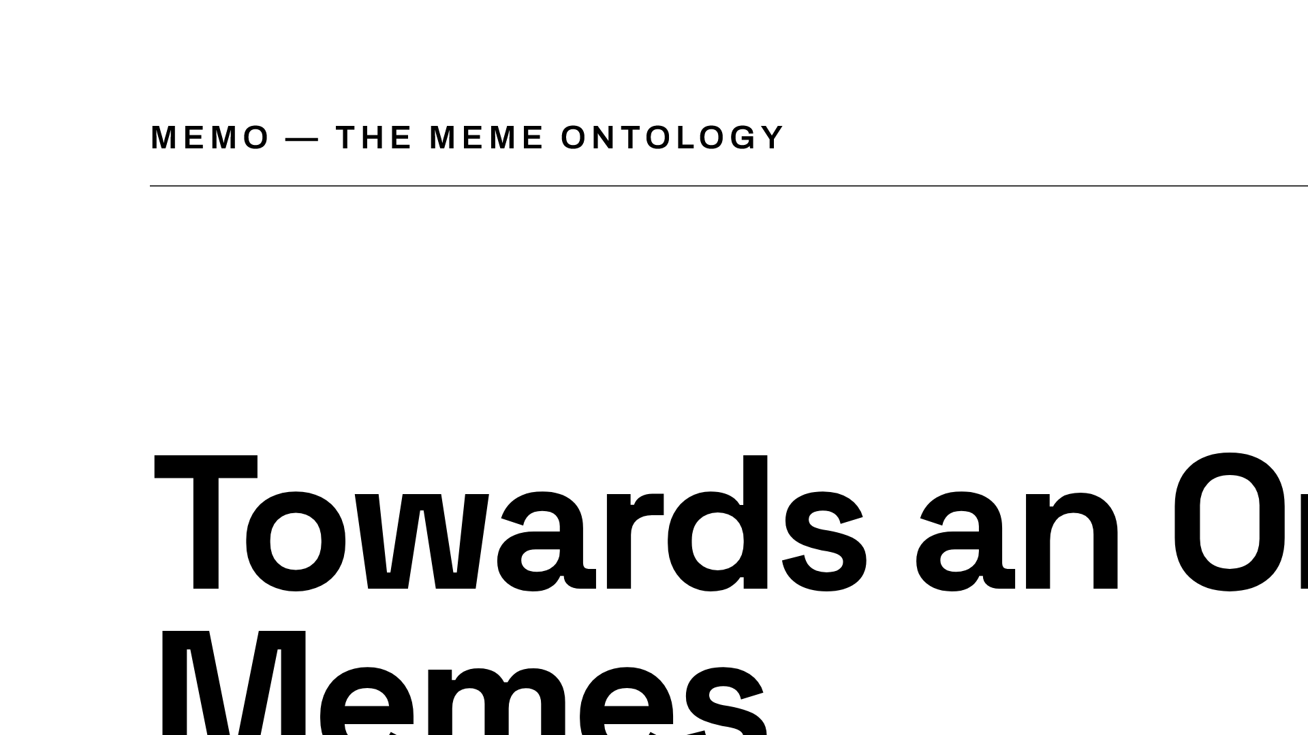
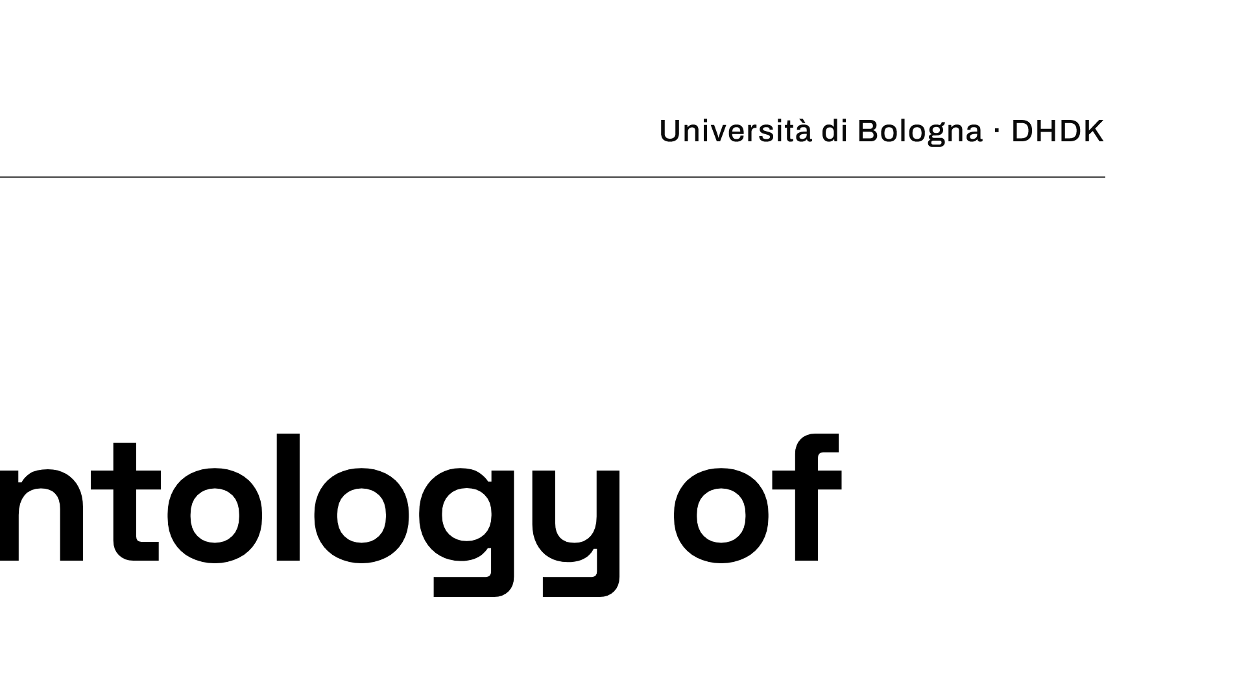
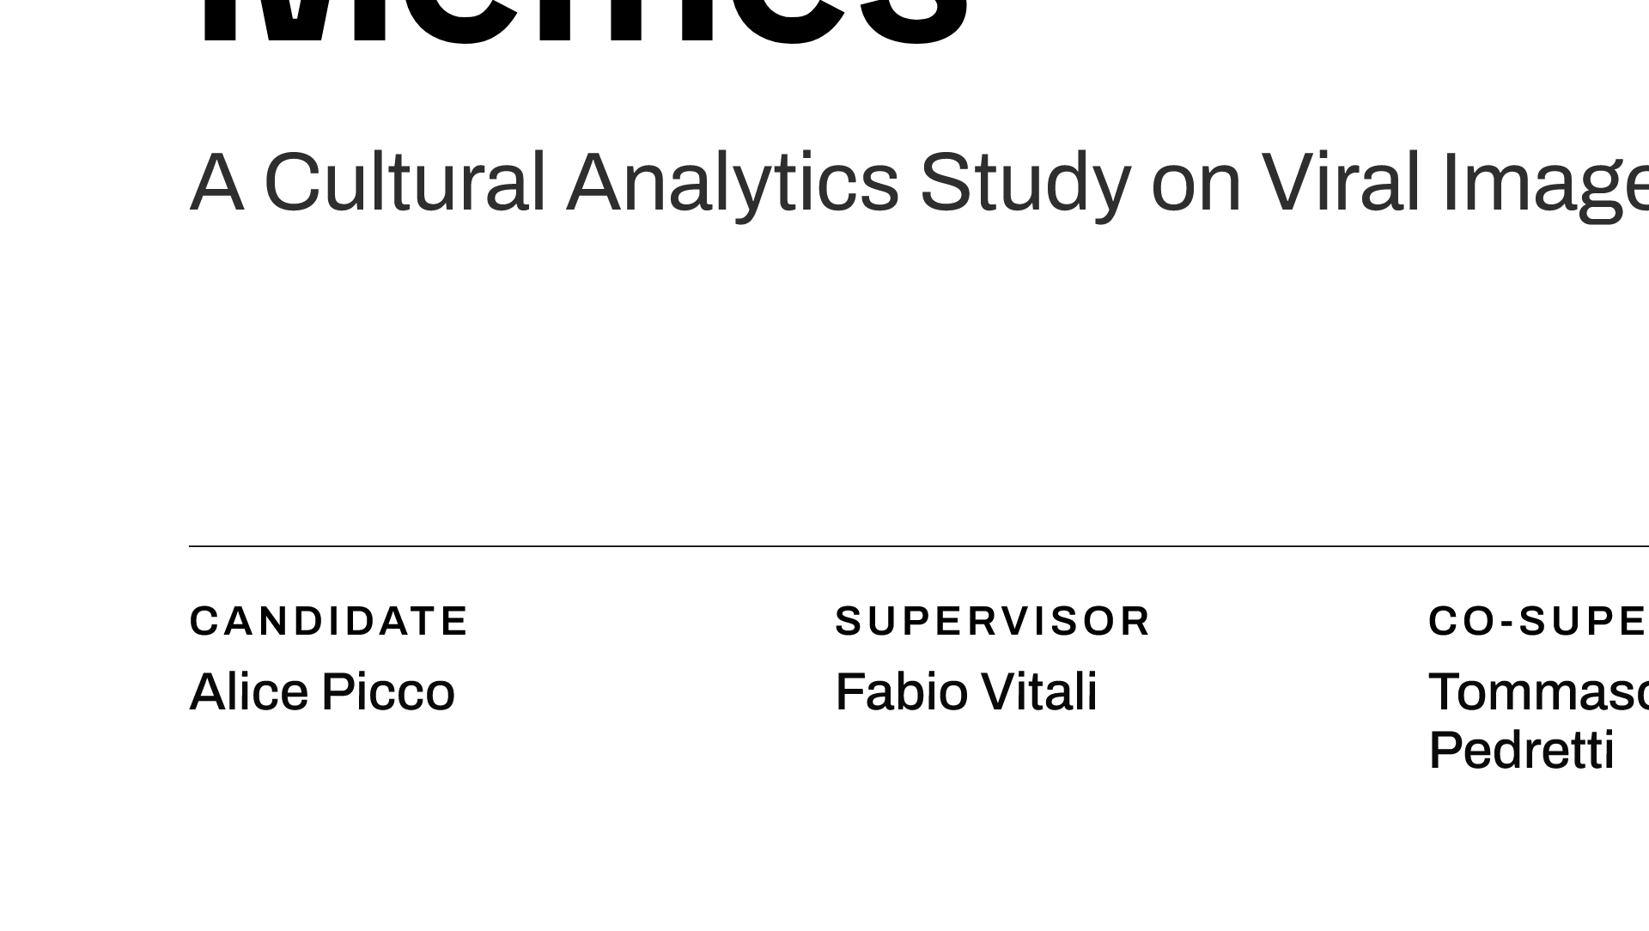
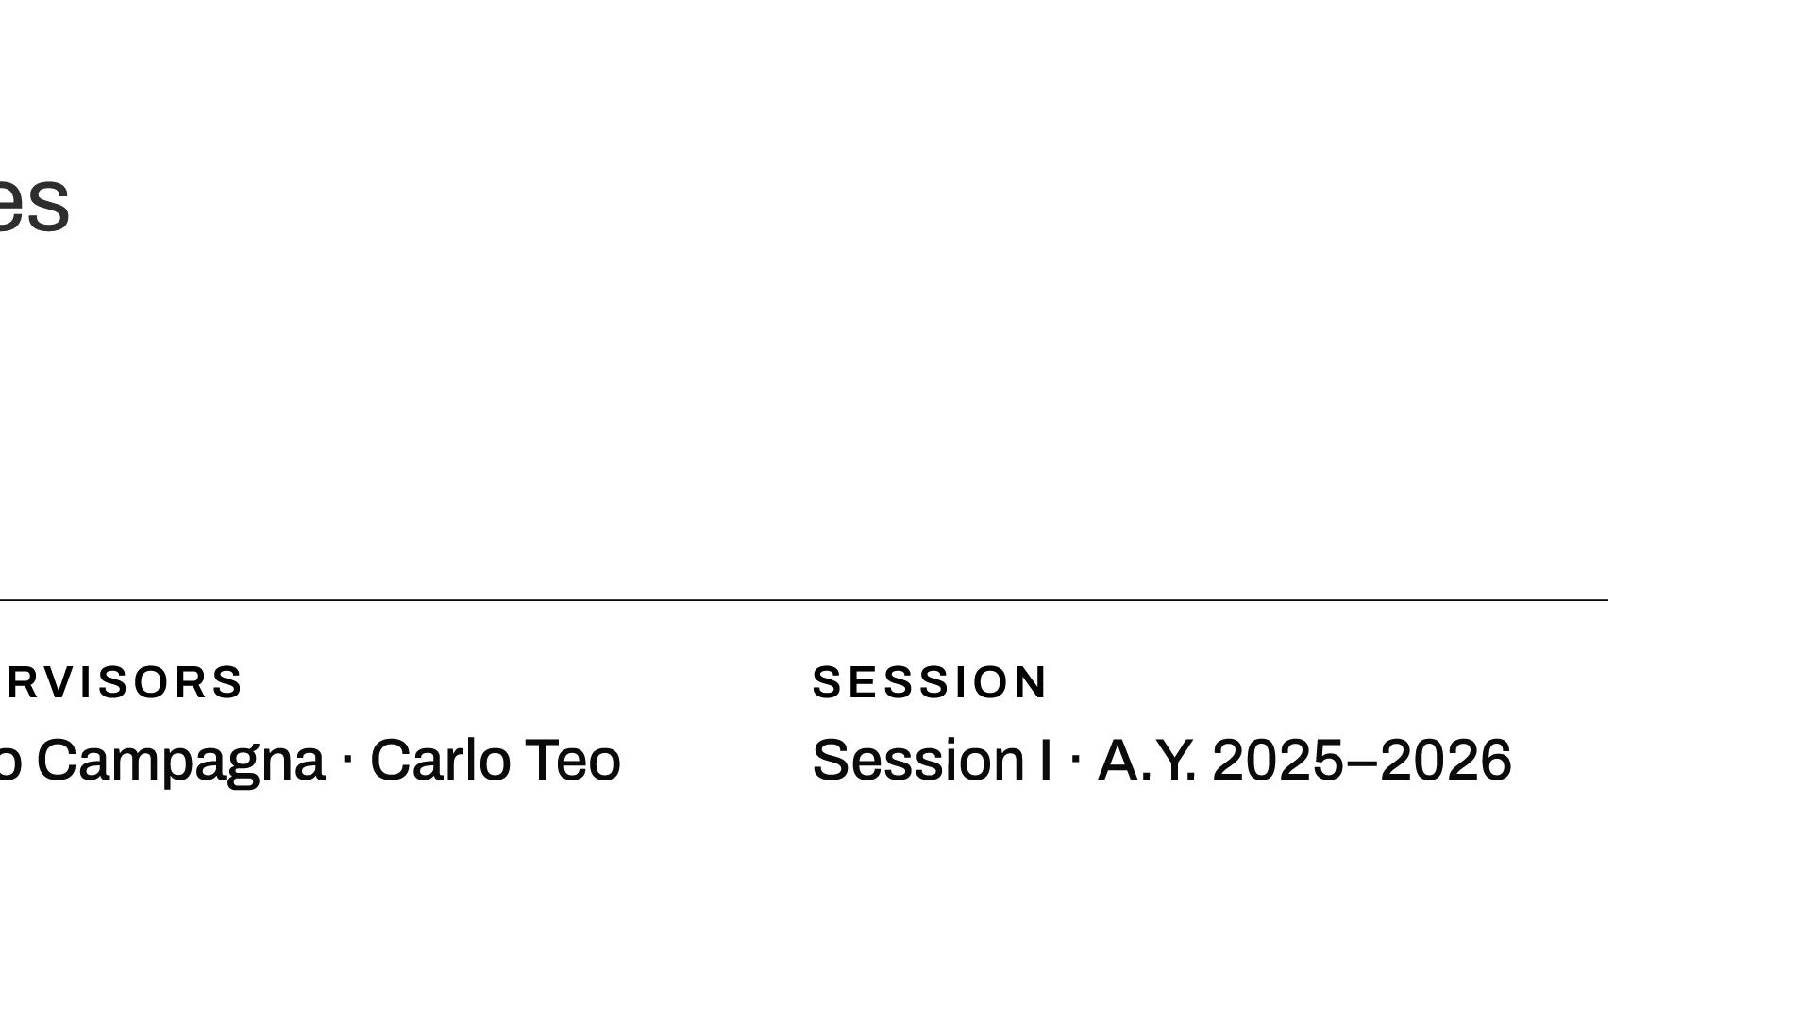
Notes:
Good morning. My thesis proposes MEMO, the MEMe Ontology: the first formal OWL domain ontology of internet memes, built at corpus scale and grounded in bibliographic and iconological theory.

Slide 2
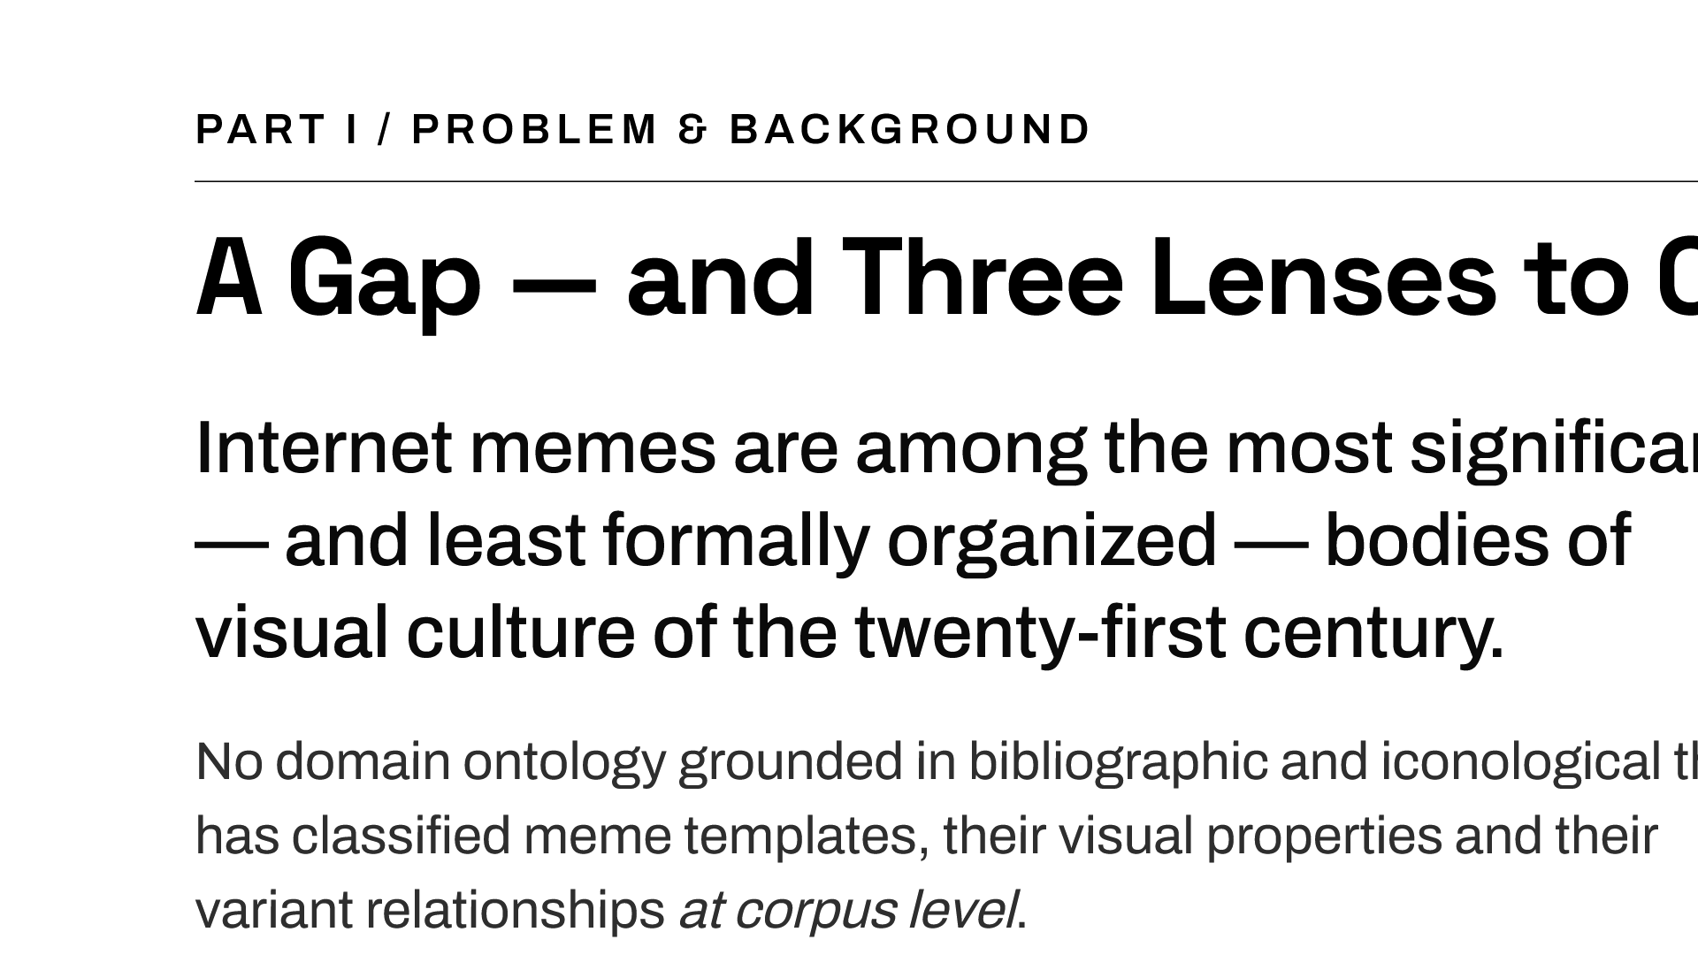
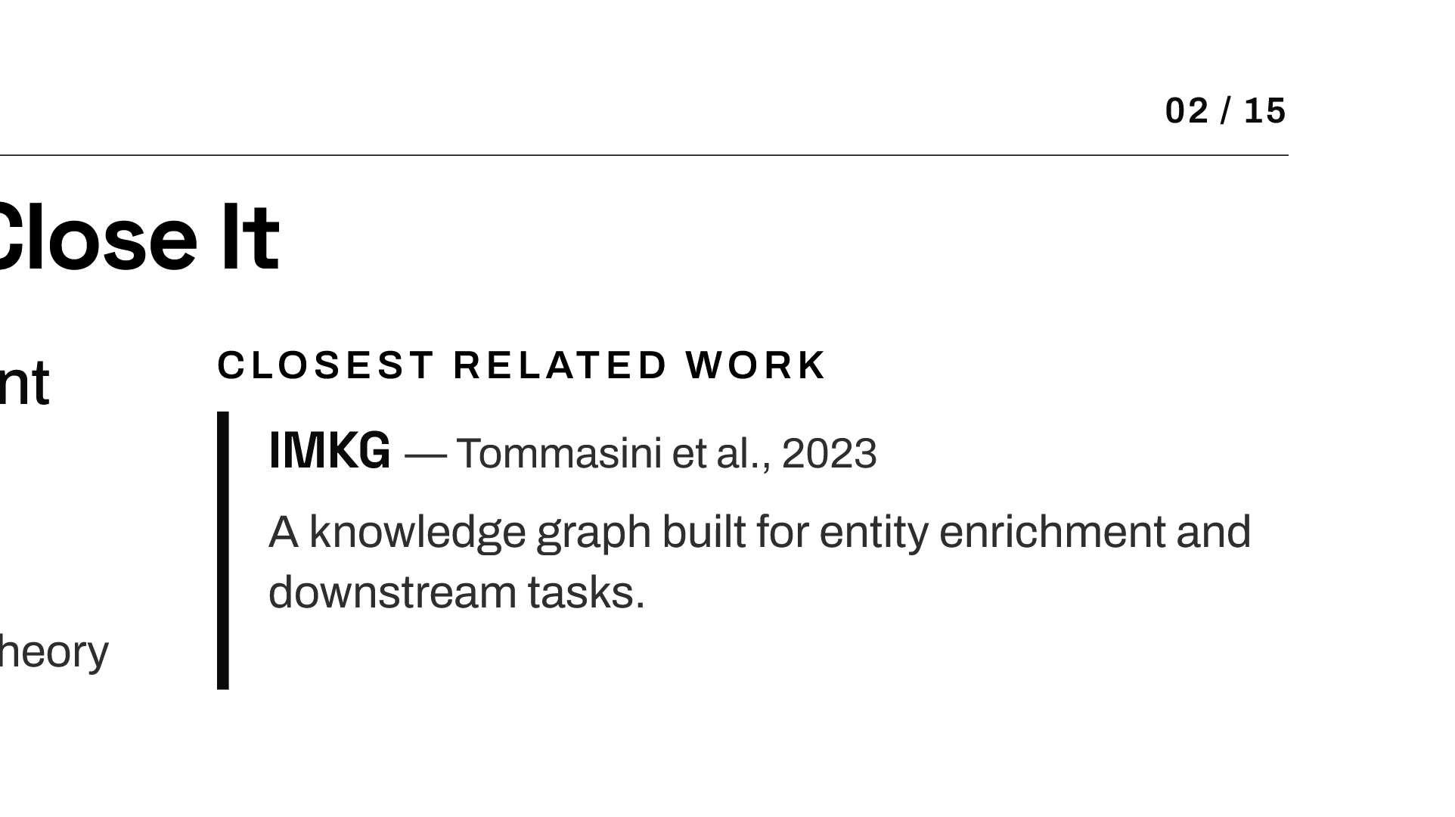
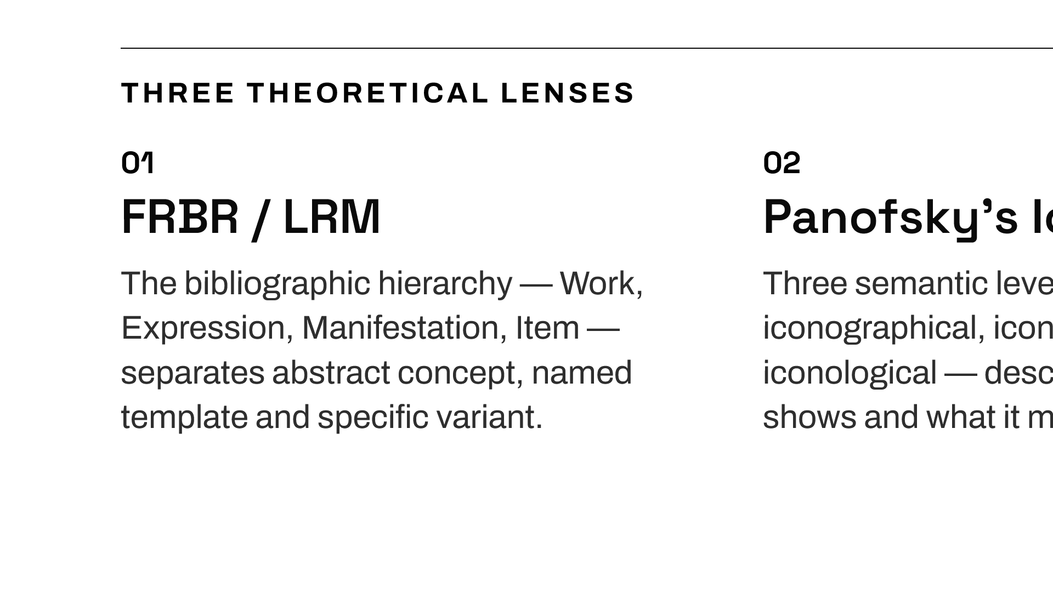
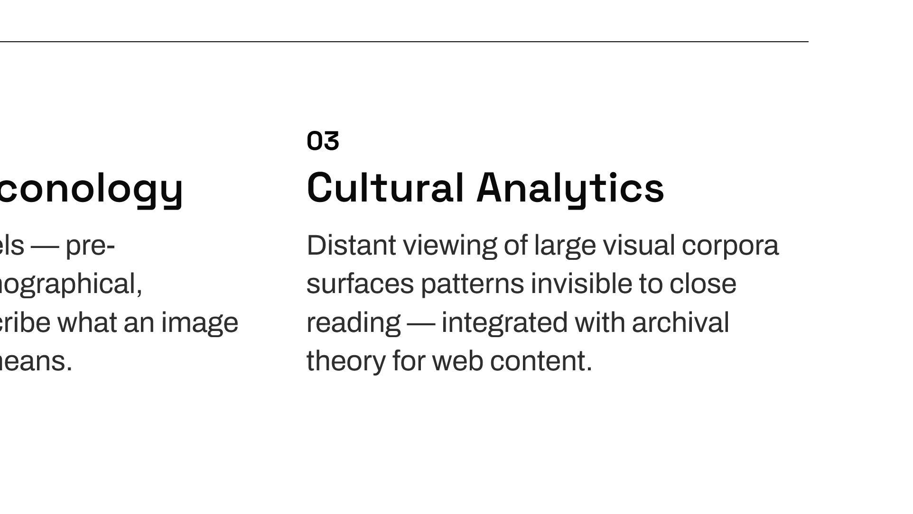
Notes:
Internet memes are a vast, relationally complex body of visual culture, yet no theory-grounded ontology has classified them at scale. The closest resource, the IMKG, is a knowledge graph for entity enrichment — MEMO's contribution is the classificatory model itself. To build it, MEMO integrates three traditions: the FRBR/LRM bibliographic model to separate concept, template and variant; Panofsky's iconology for visual meaning; and cultural analytics for distant viewing of large visual corpora.

Slide 3
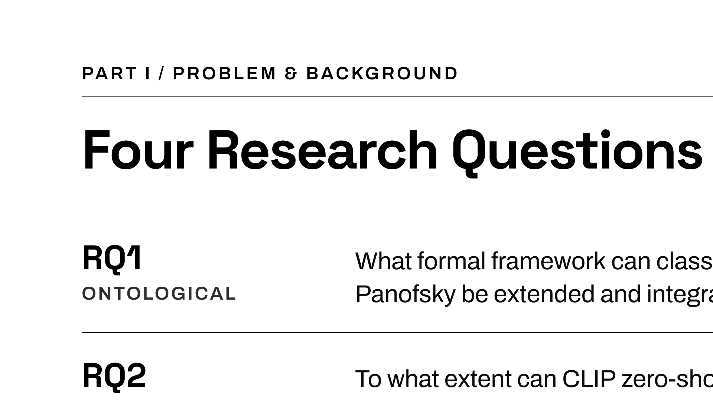
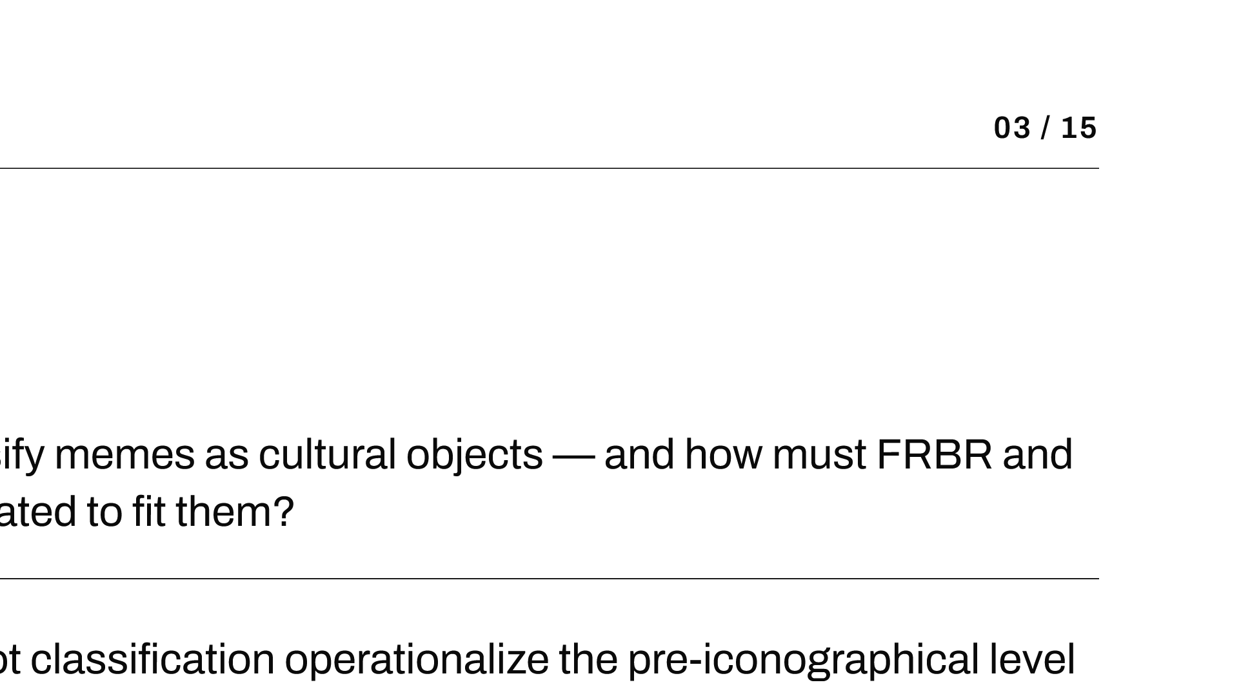
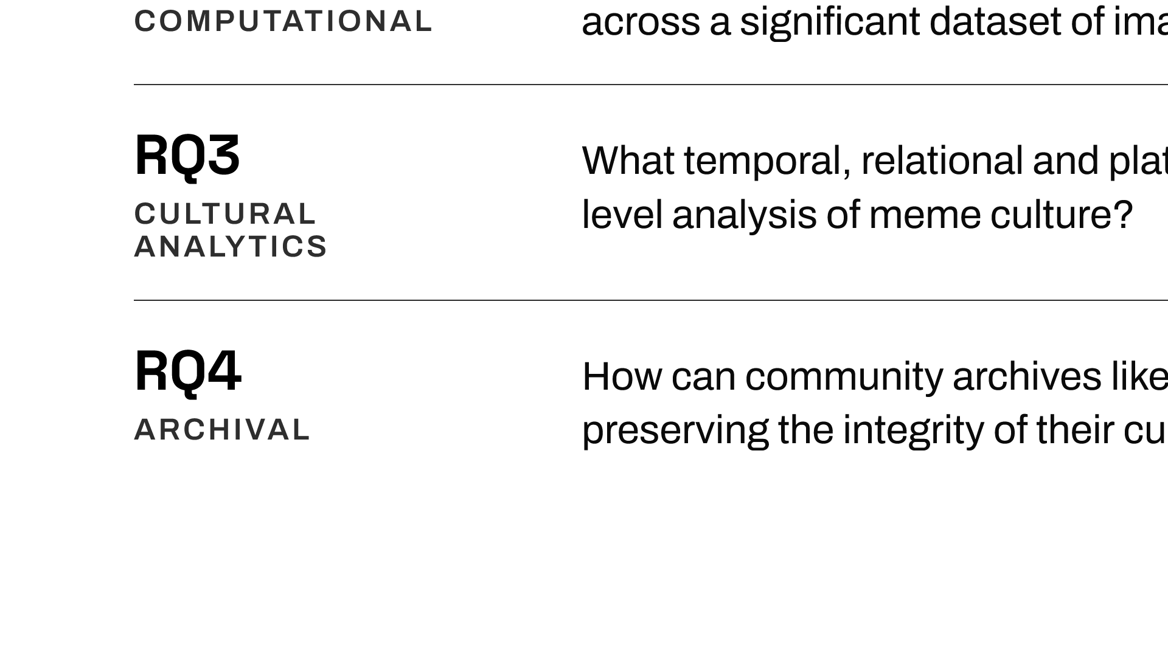
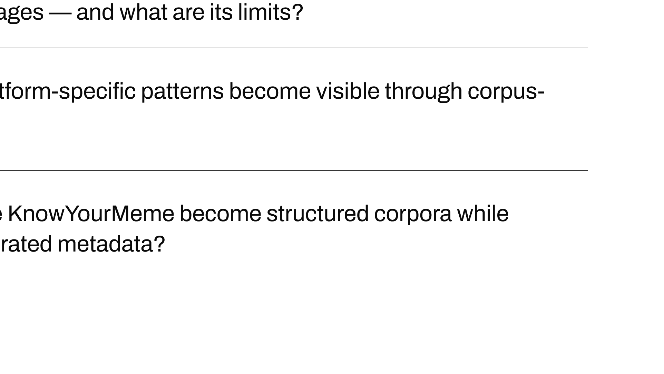
Notes:
Four research questions: ontological adequacy, computational operationalization with CLIP, corpus-level cultural patterns, and the archival question of turning a community folksonomy into a research corpus.

Slide 4
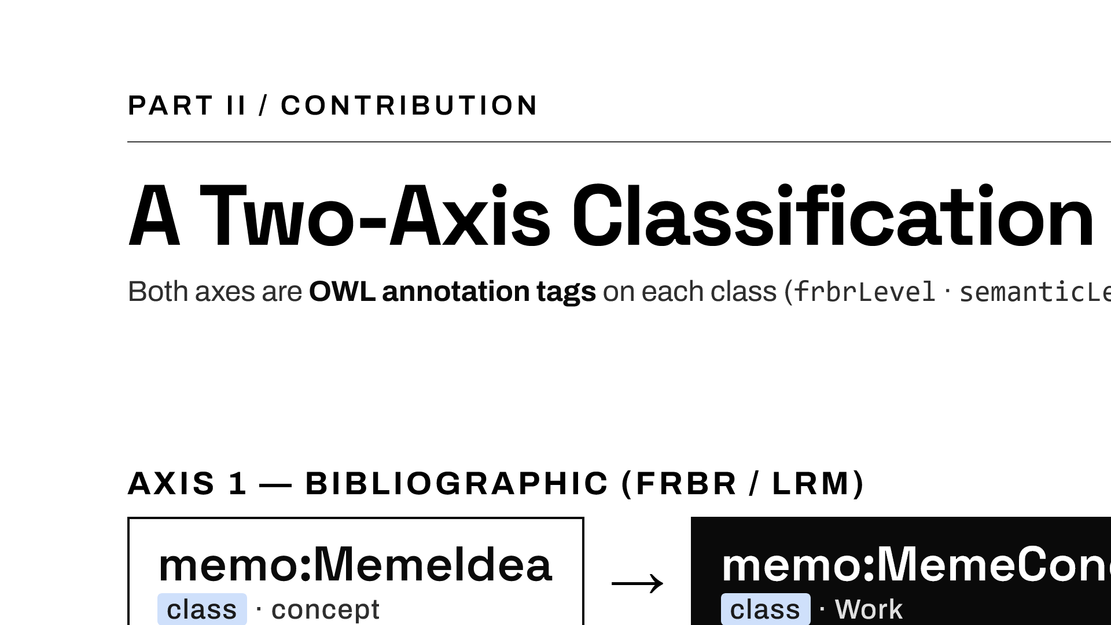
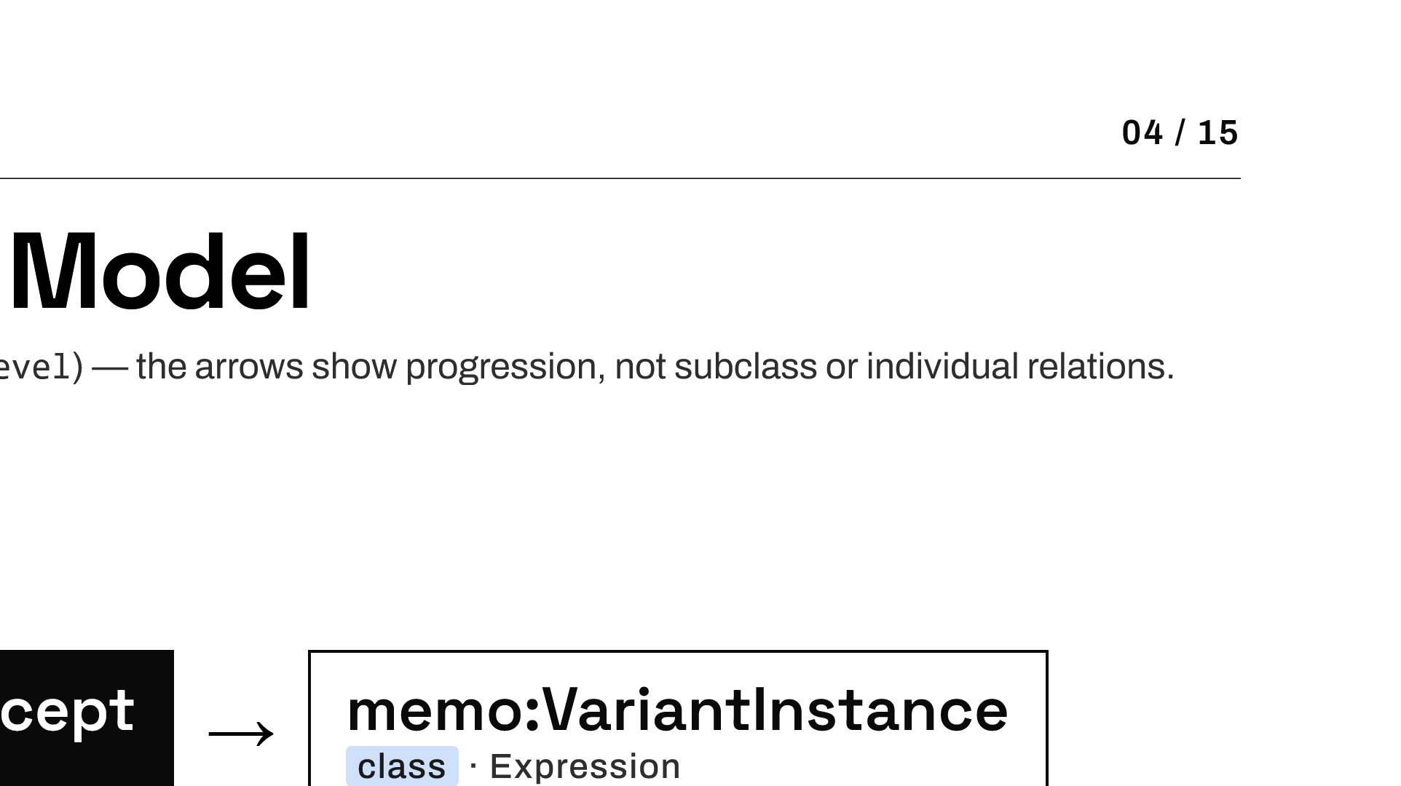
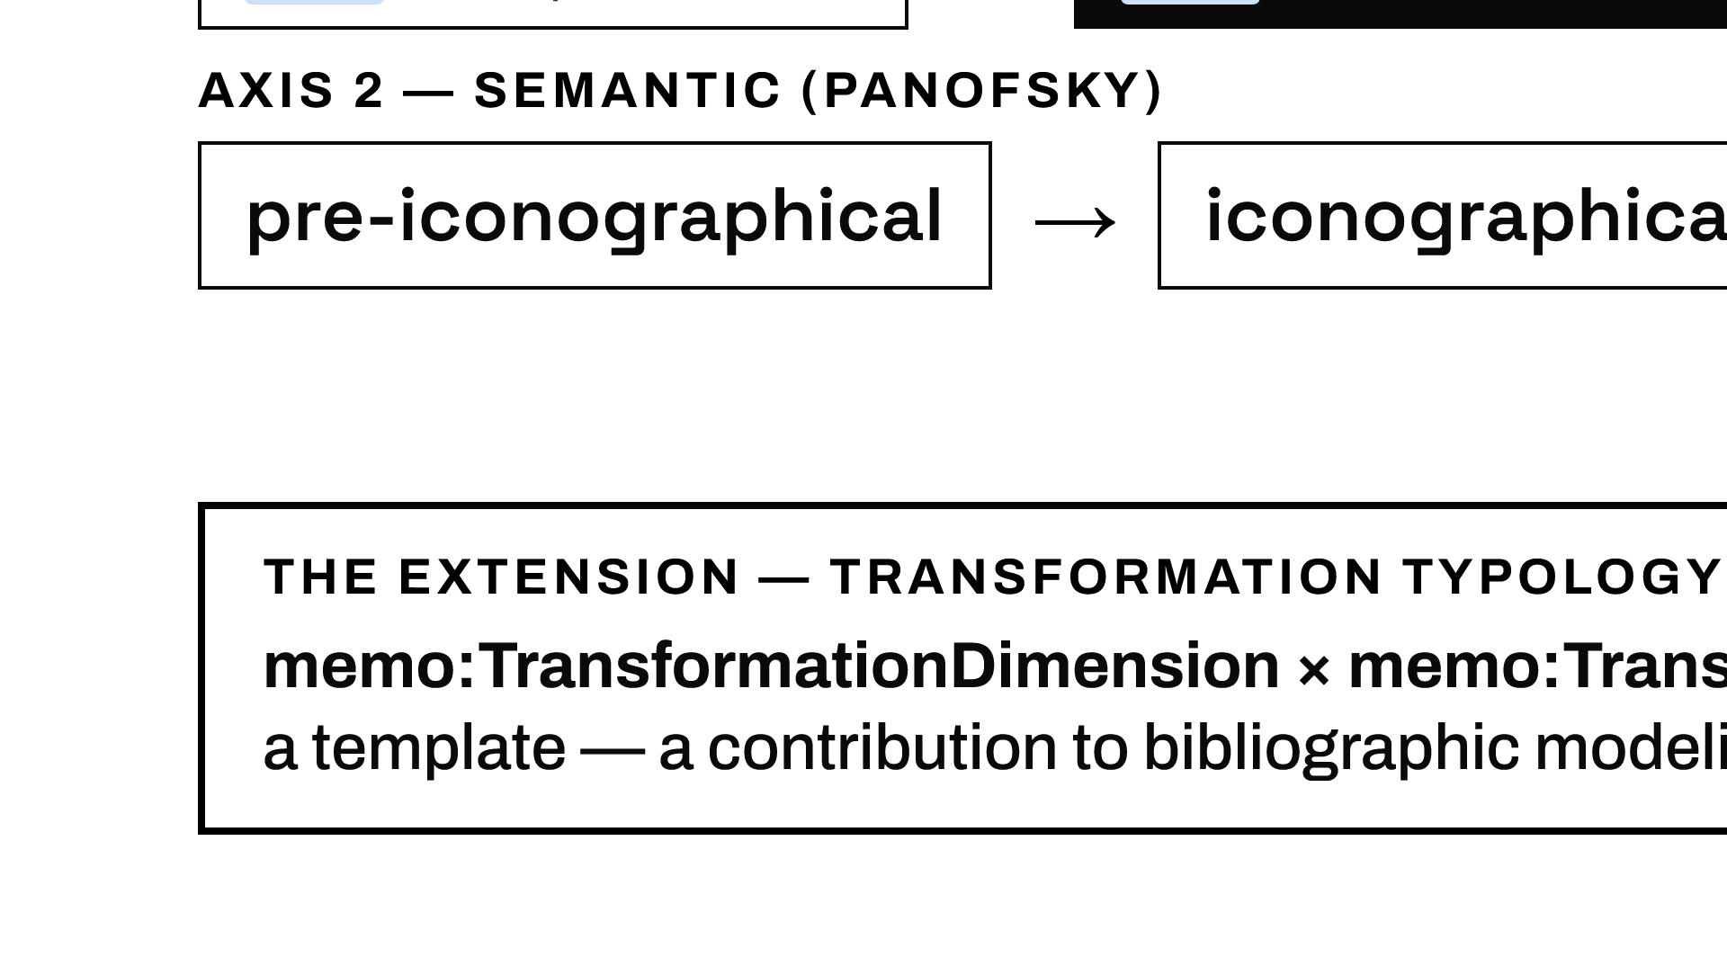
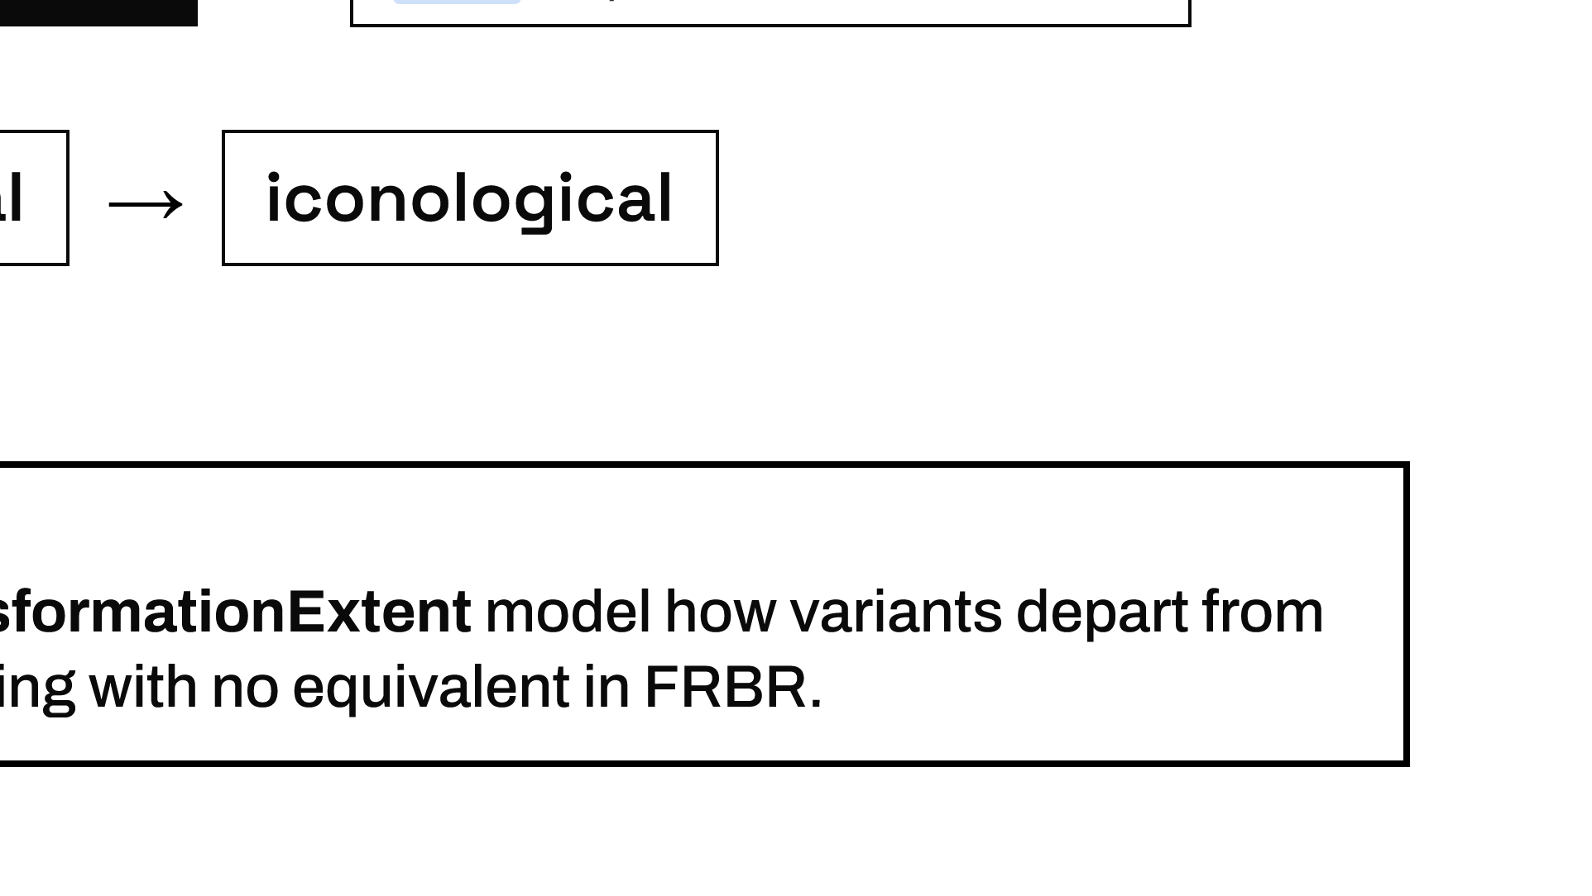
Notes:
MEMO is organized along two parallel axes expressed as OWL annotation properties: the FRBR bibliographic levels and the Panofsky semantic levels. The genuine extension is the transformation typology at the Expression level, which has no equivalent in FRBR. The ontology is an OWL 2 DL artifact: 33 classes, 28 object and 14 data properties, around 6,500 individuals.

Slide 5
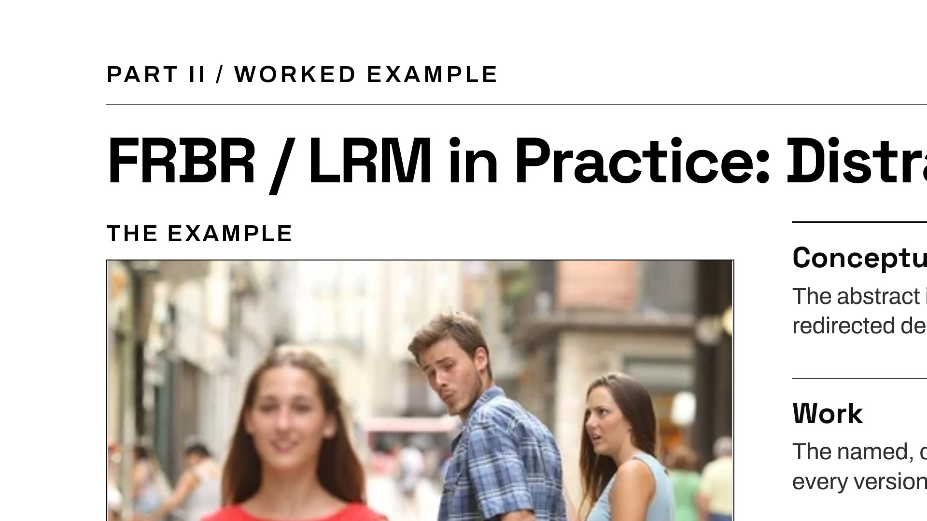
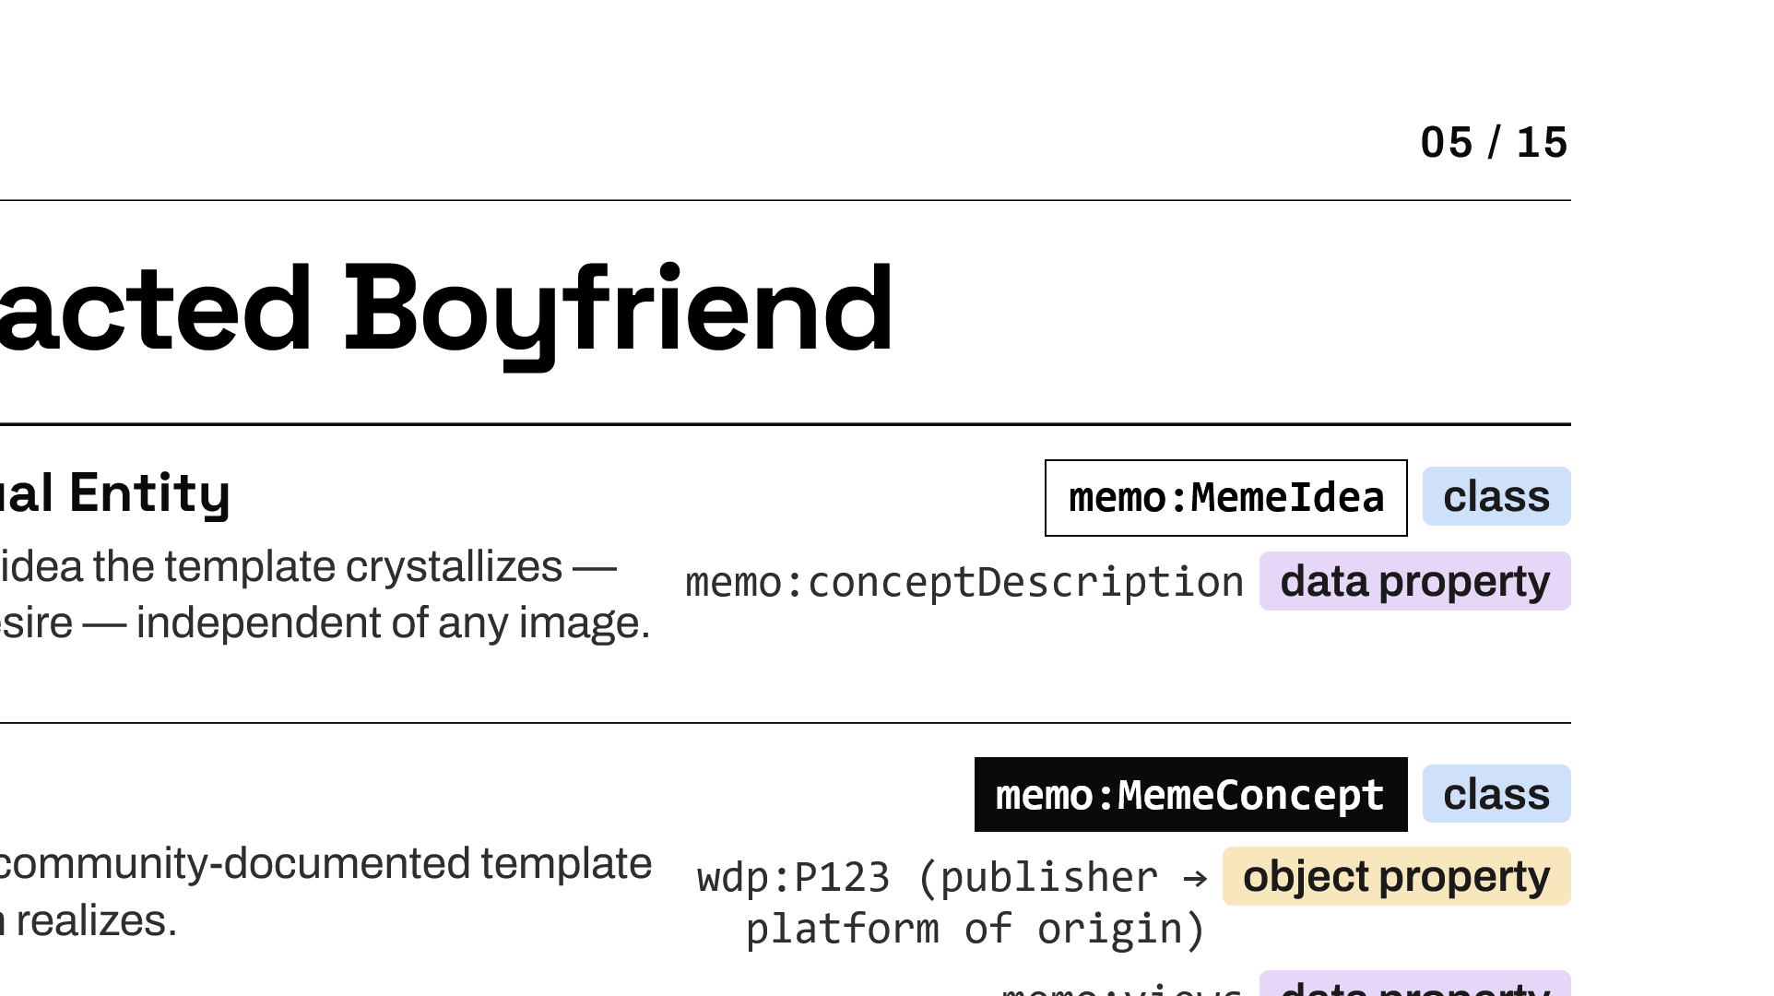
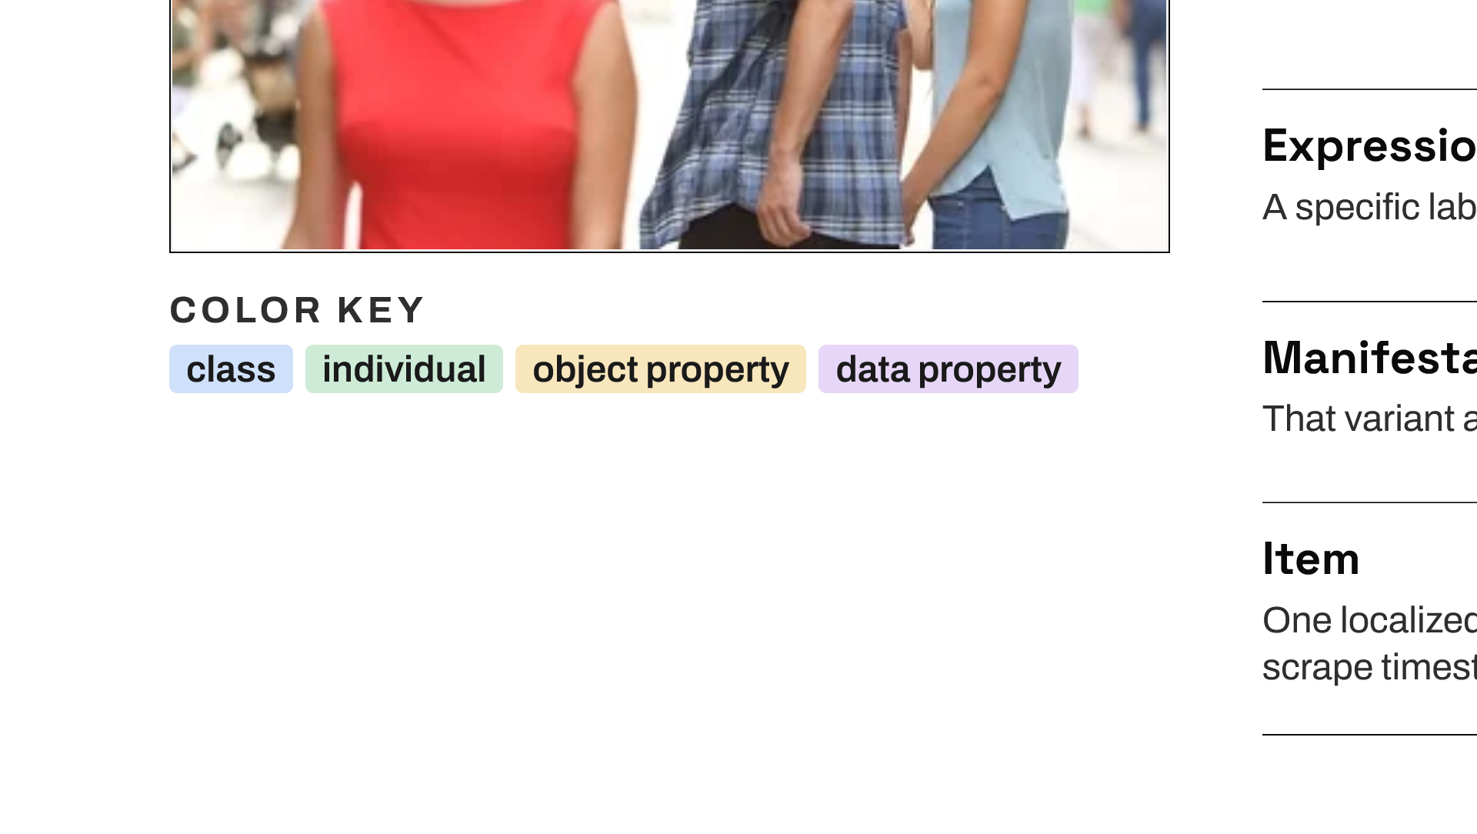
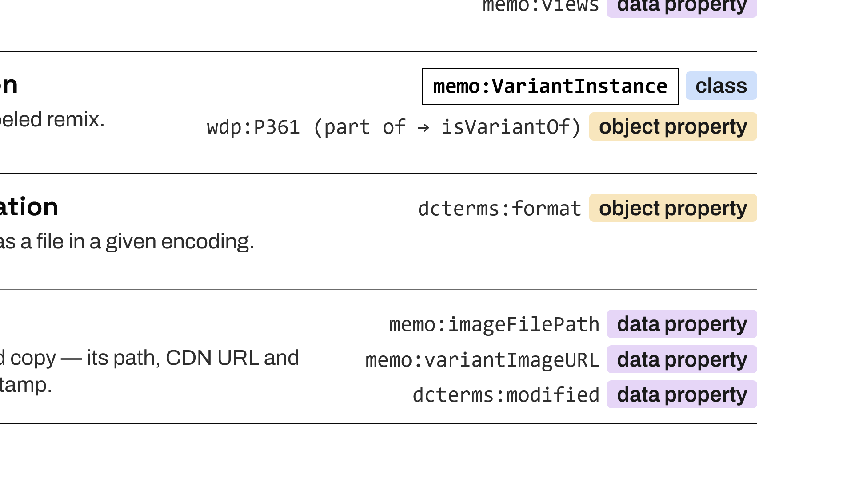
Notes:
Take Distracted Boyfriend. As a conceptual entity it is the abstract idea of redirected desire — that becomes a memo:MemeIdea. As a Work it is the named template documented on KnowYourMeme — a memo:MemeConcept. Each labeled remix is an Expression — a memo:VariantInstance linked to the Work by part-of. Manifestation and Item information — the JPEG, the resolution, the CDN URL, the timestamp — are recorded through properties rather than classes. Note the canonical original photo is recorded directly on the Work as a documented denormalization.

Slide 6
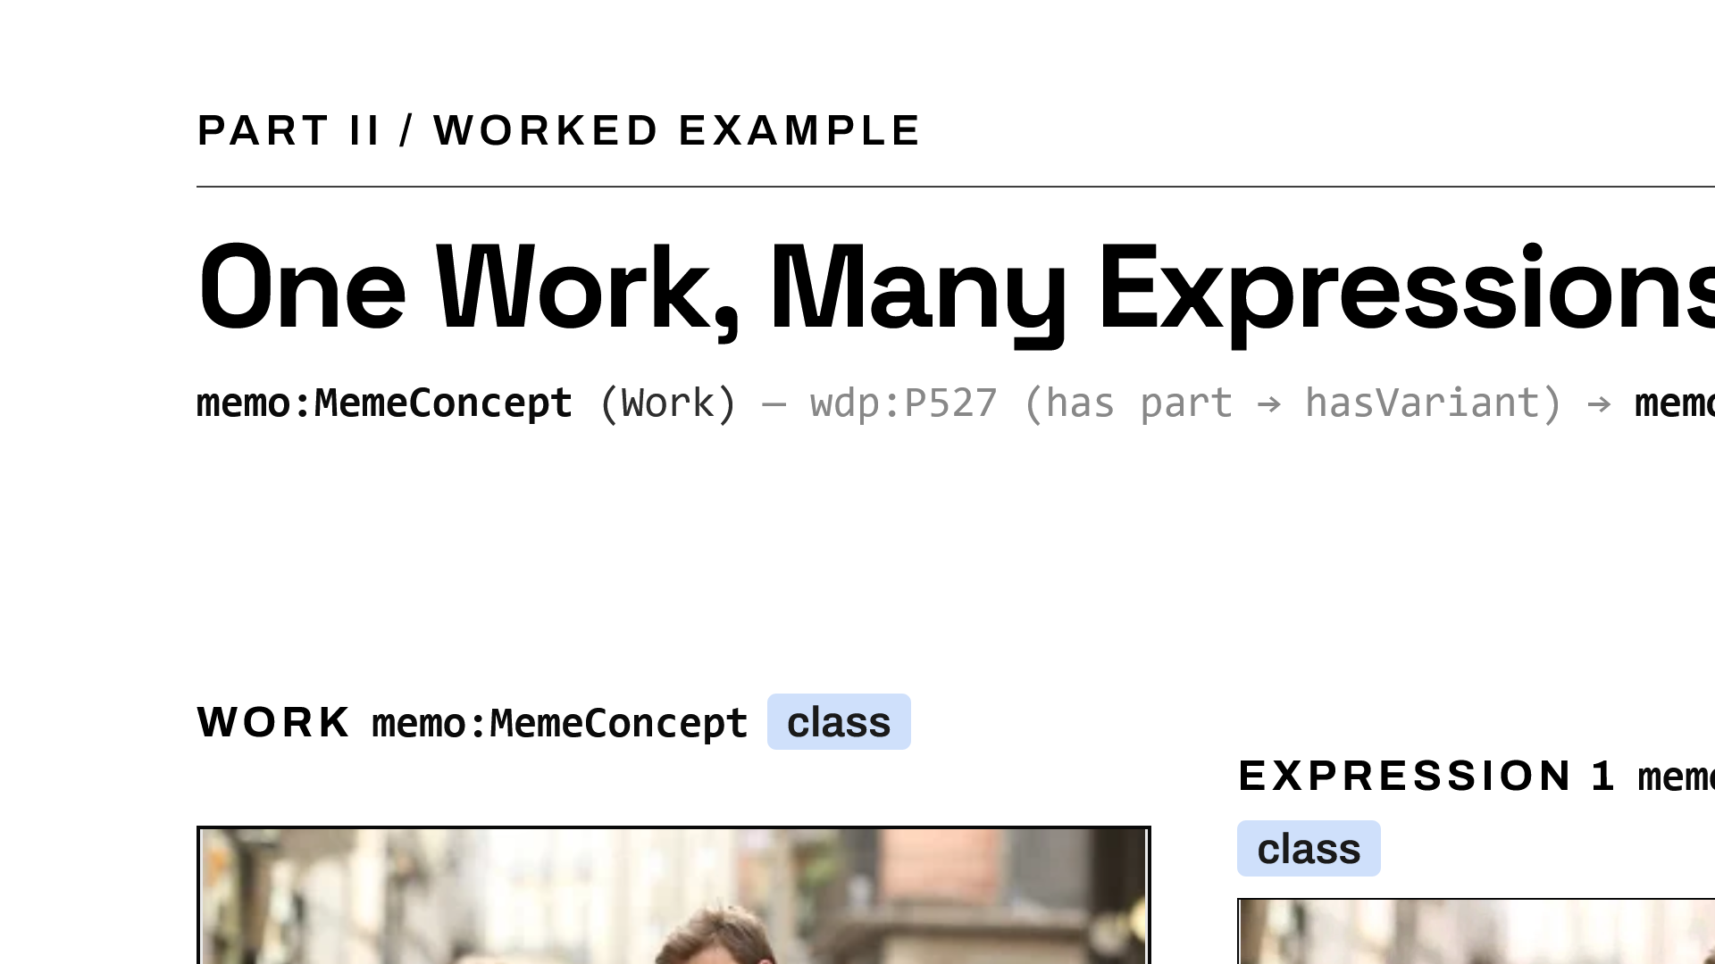
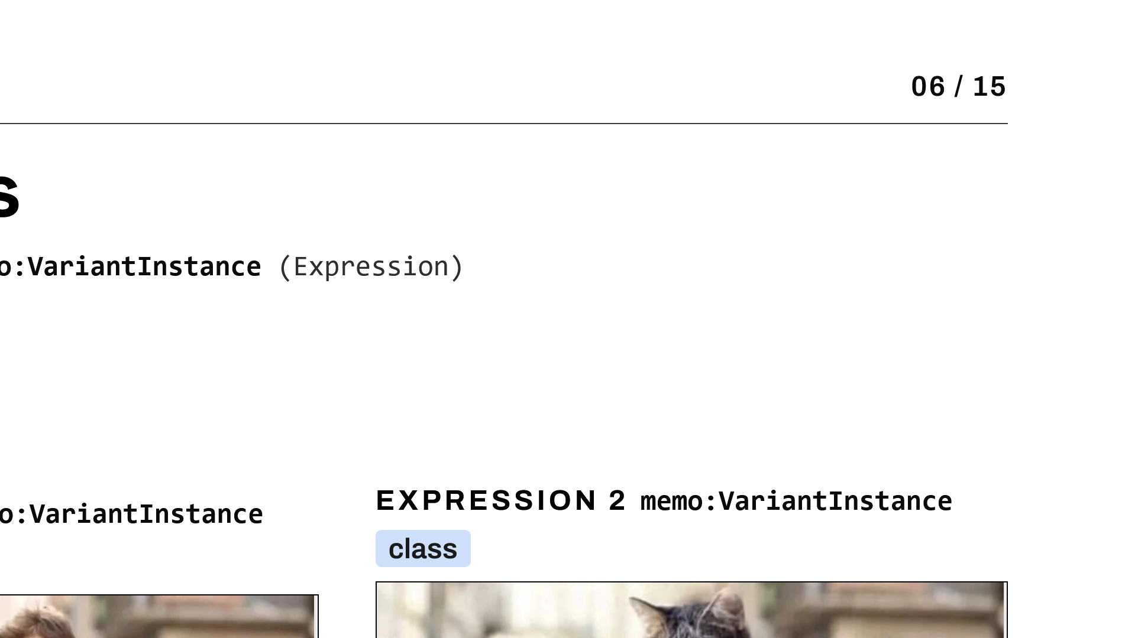
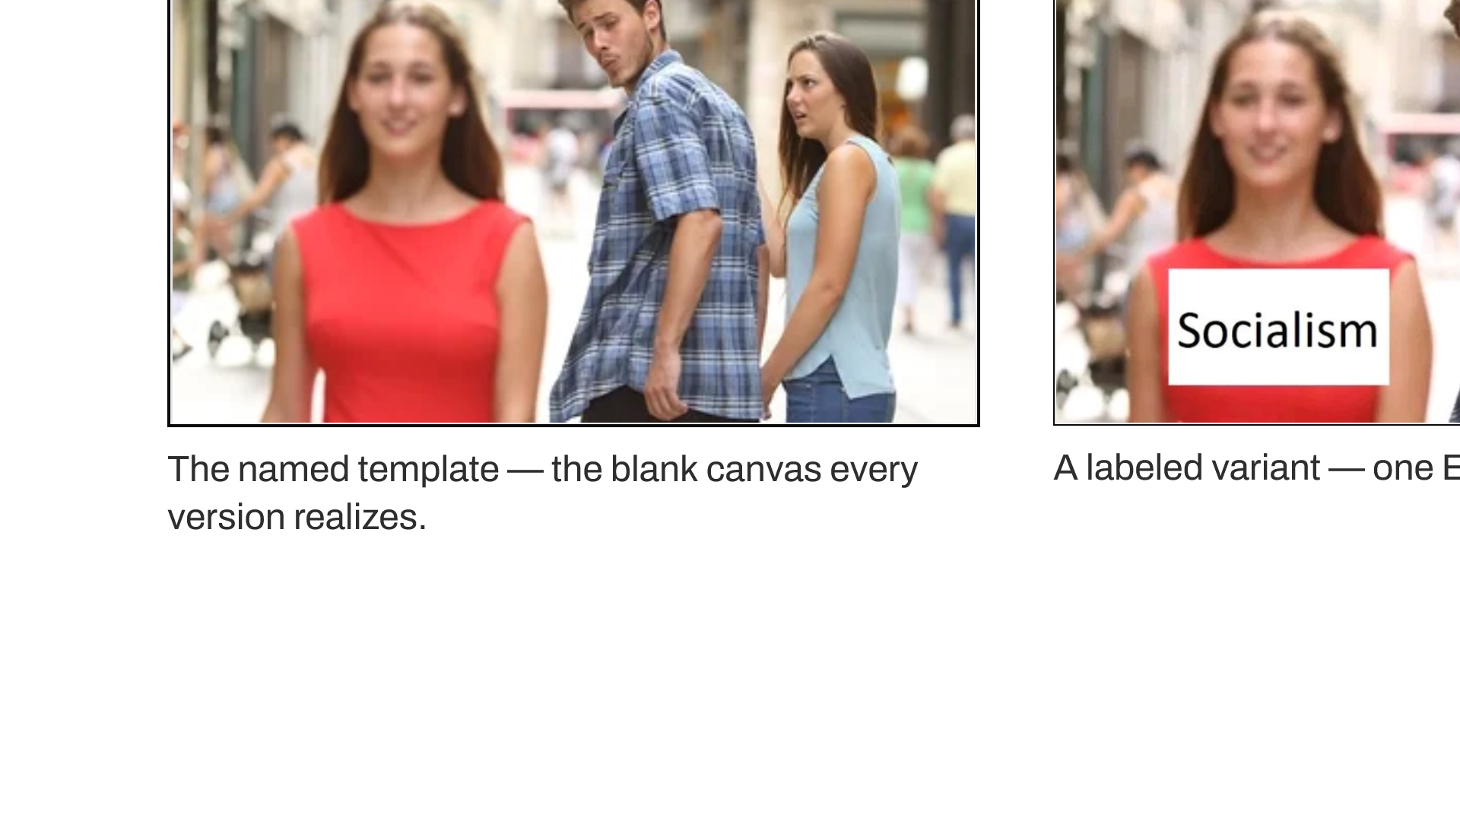
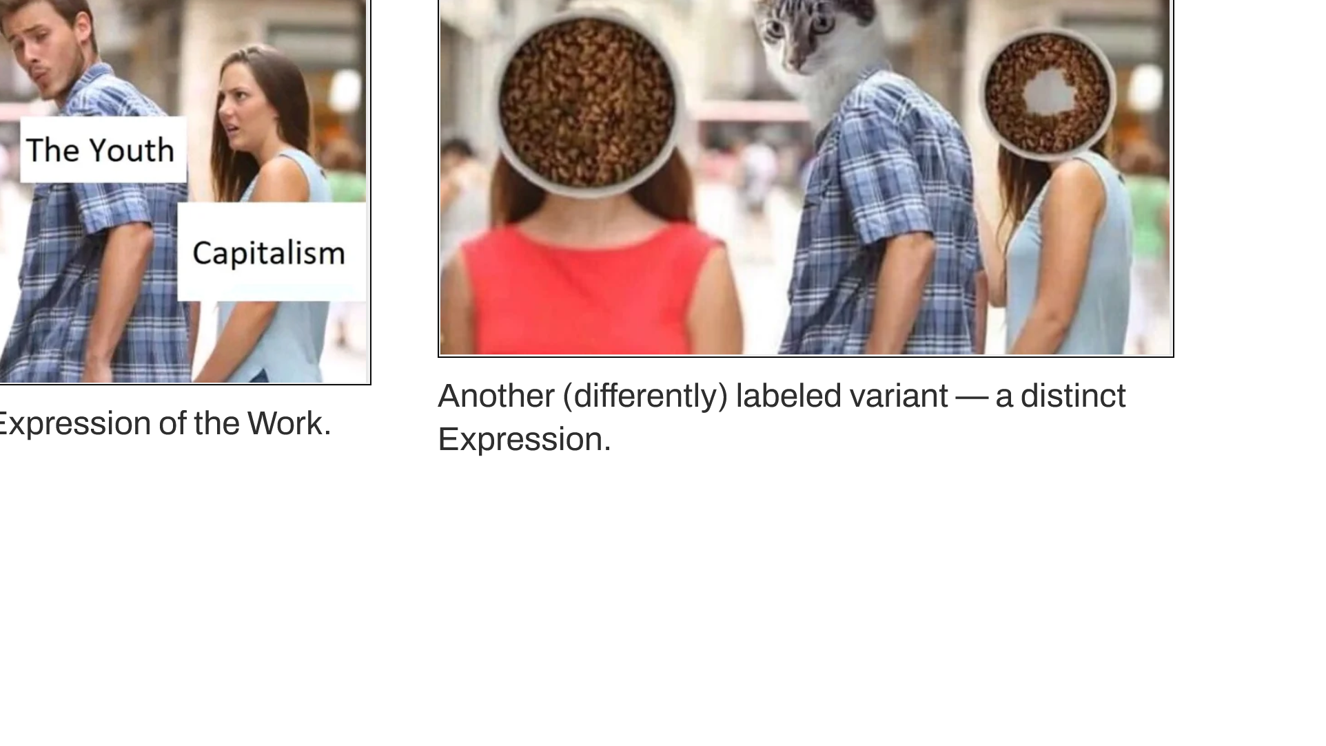
Notes:
The same relationship, made visual. At the top, the Work: the unlabeled template — a single memo:MemeConcept. Below it, two Expressions: distinct labeled variants, each a memo:VariantInstance linked back to the same Work by wdp:P361. One template, many realizations — and the variant level carries analytical information that neither the metadata nor the concept-level description alone could provide.

Slide 7
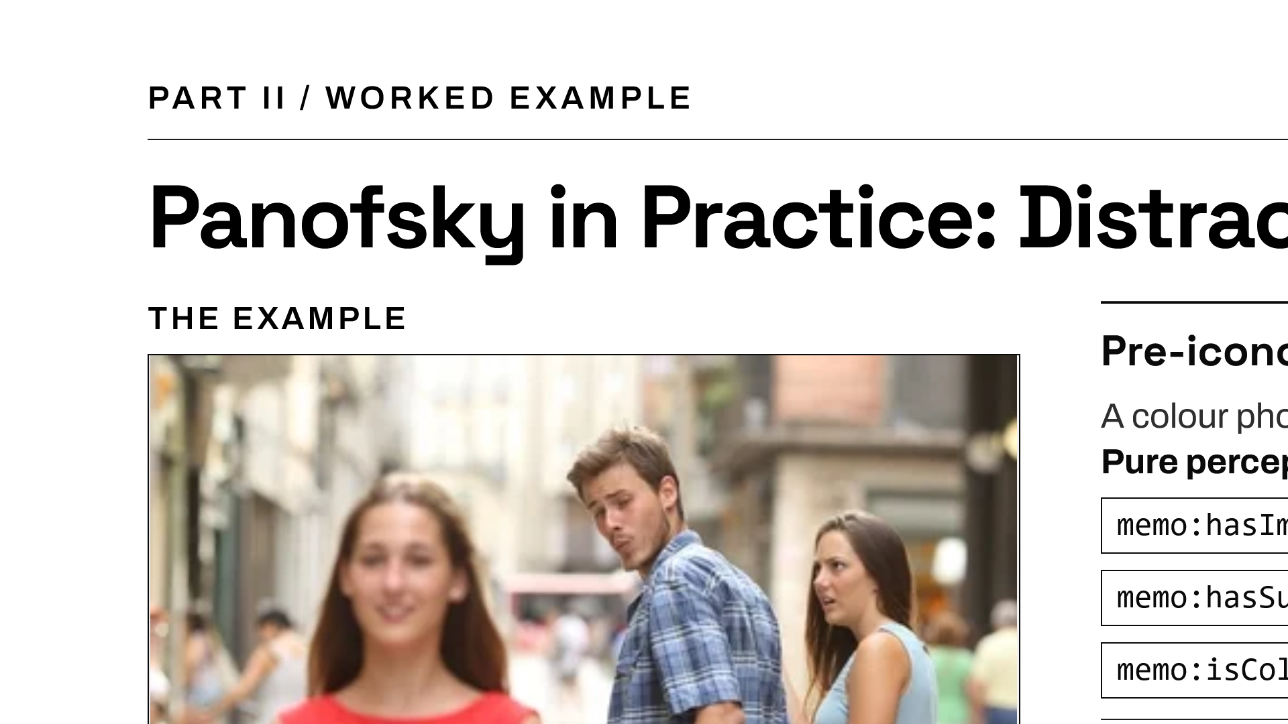
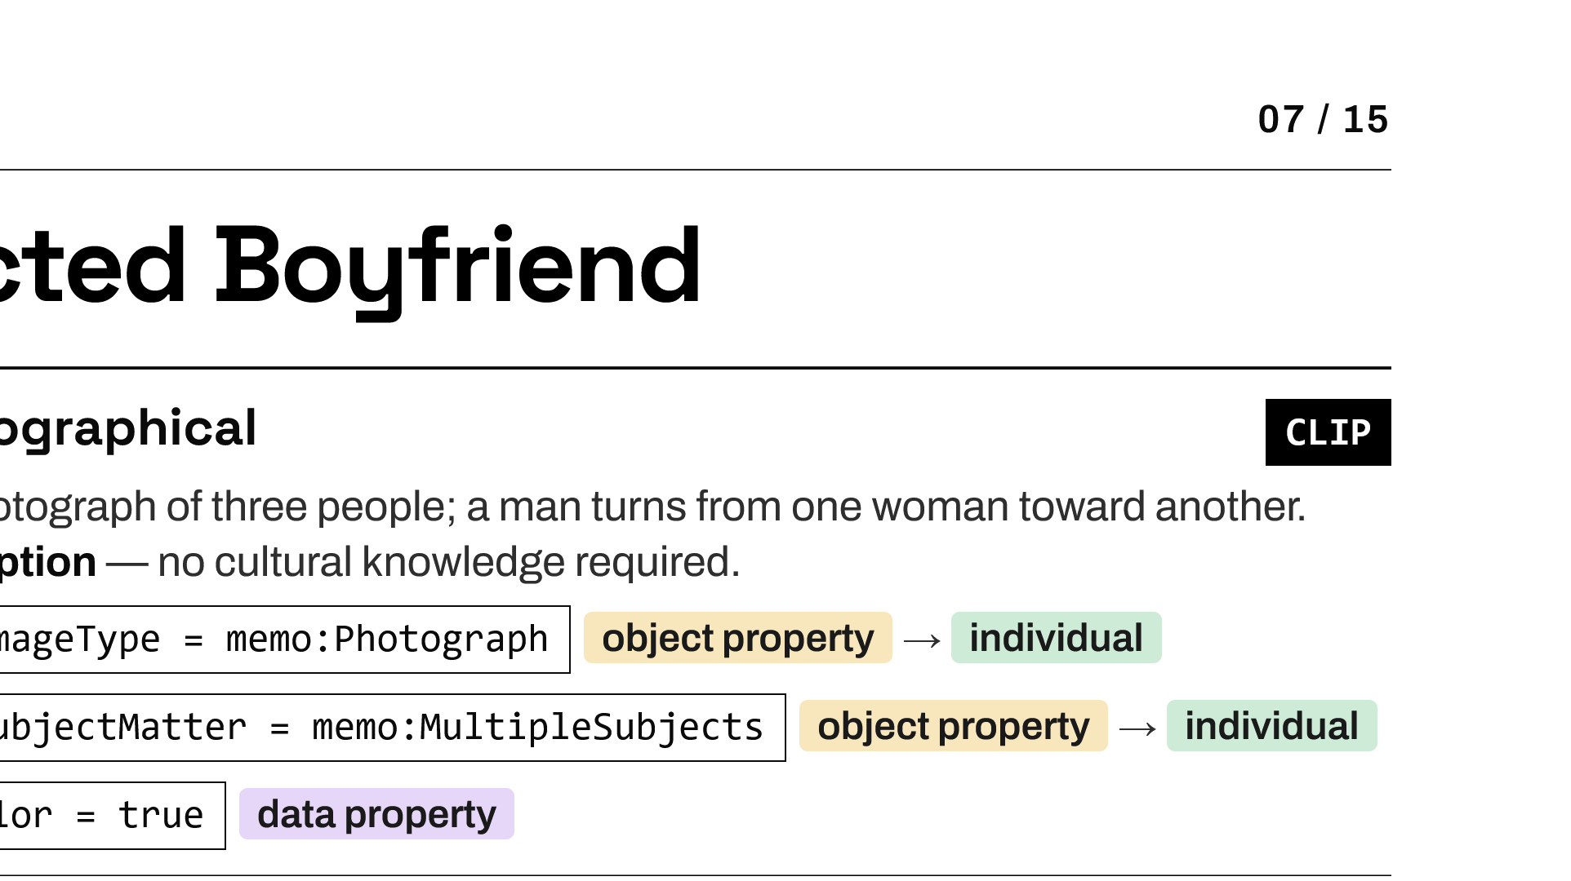
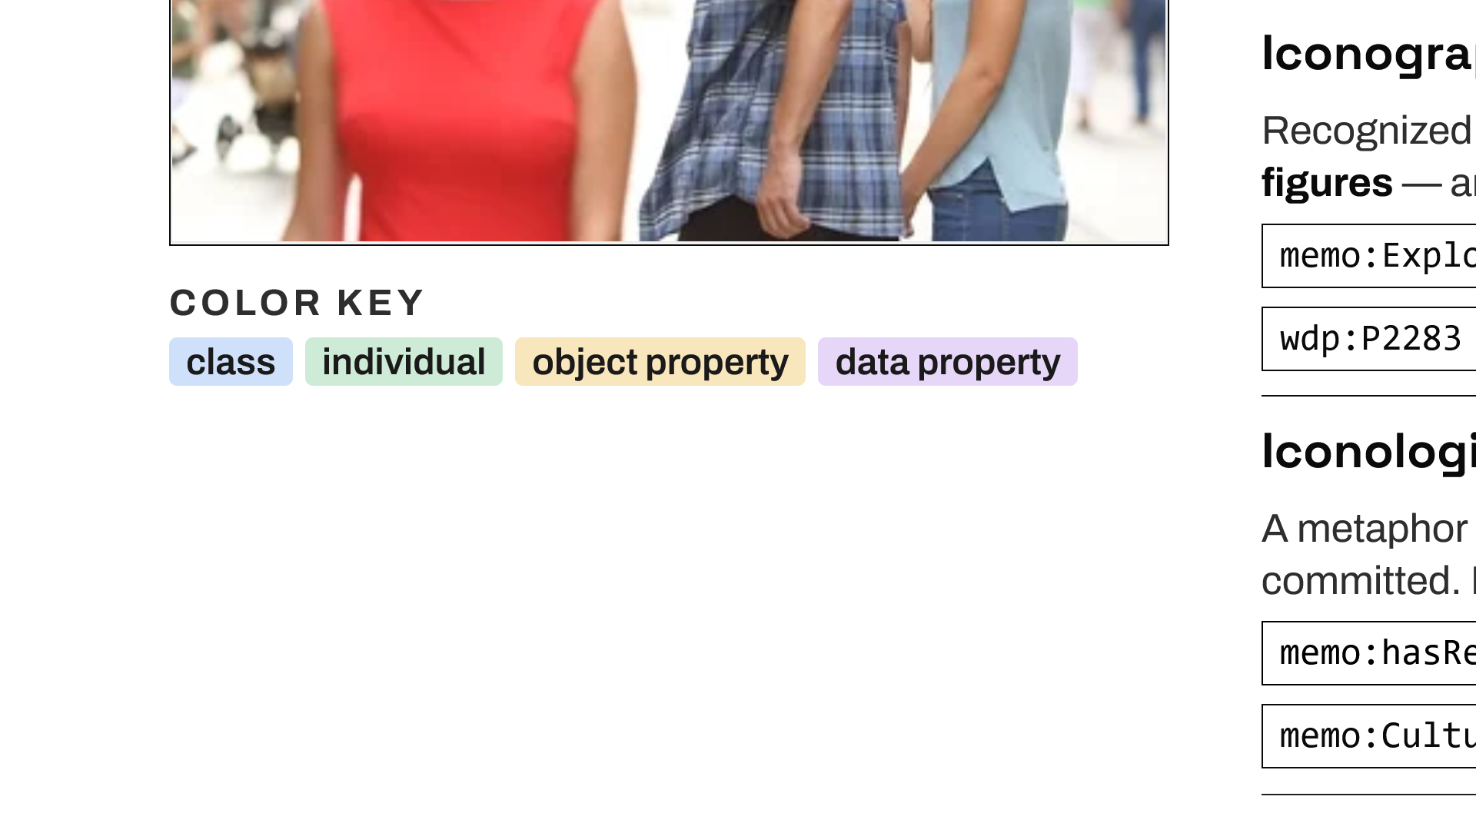
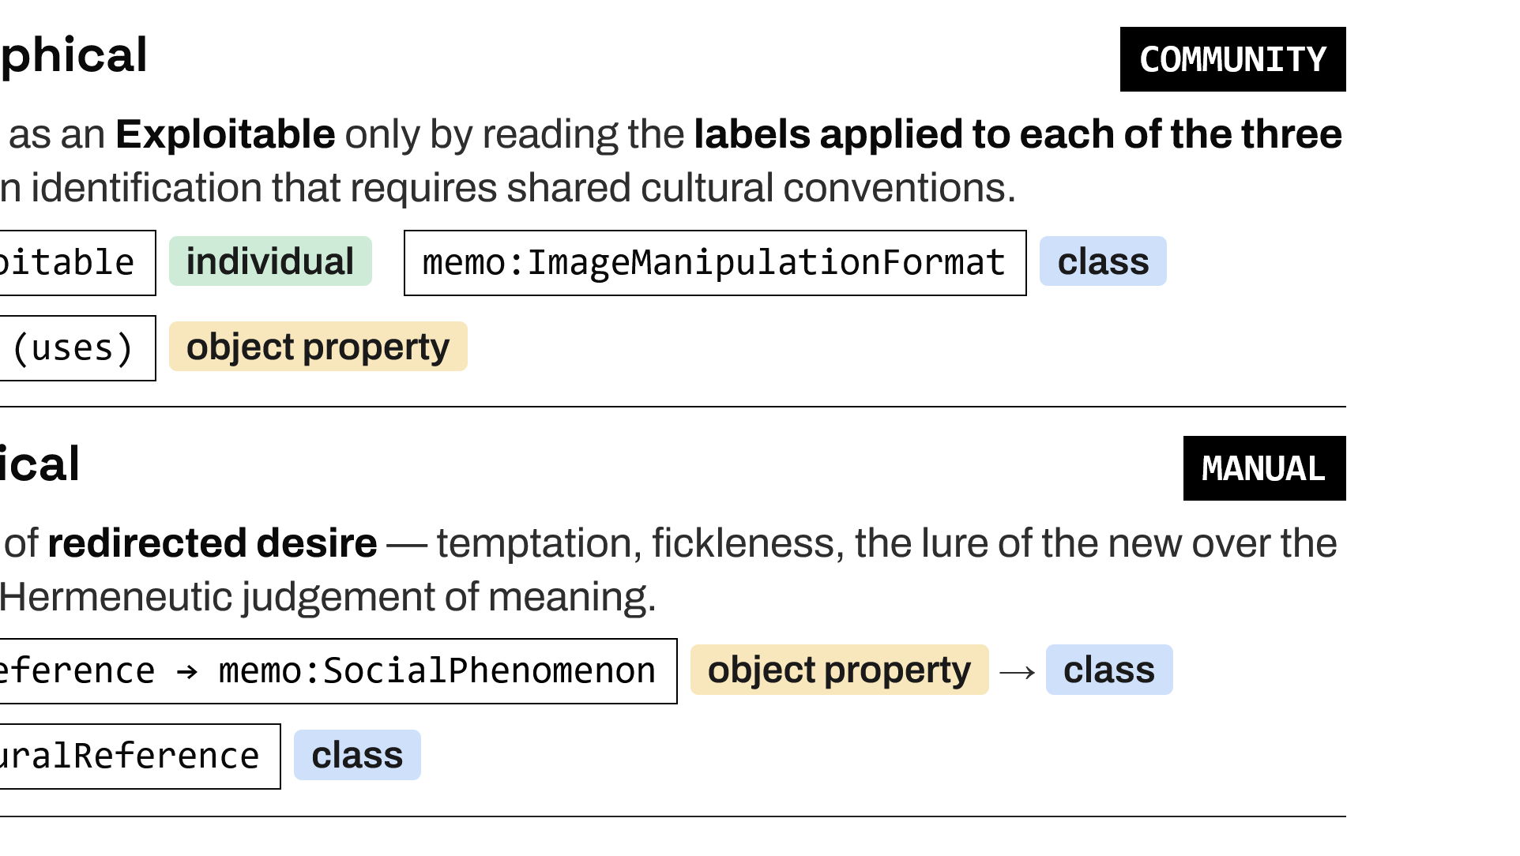
Notes:
The same meme read through Panofsky. Pre-iconographically it is just a colour photograph of three people — and those are exactly the properties CLIP assigns. Iconographically it is an Exploitable — its figures are relabeled — a format recorded from the community's own type tags. Iconologically it is a metaphor of redirected desire — a cultural reference that only manual, interpretive annotation can supply. The three semantic levels are also the division of annotation labor.

Slide 8
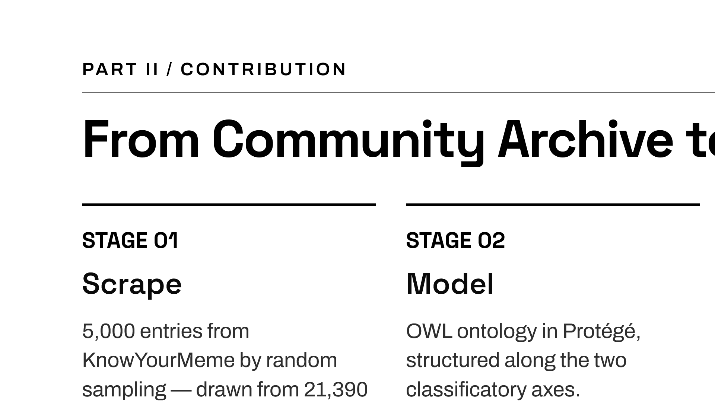
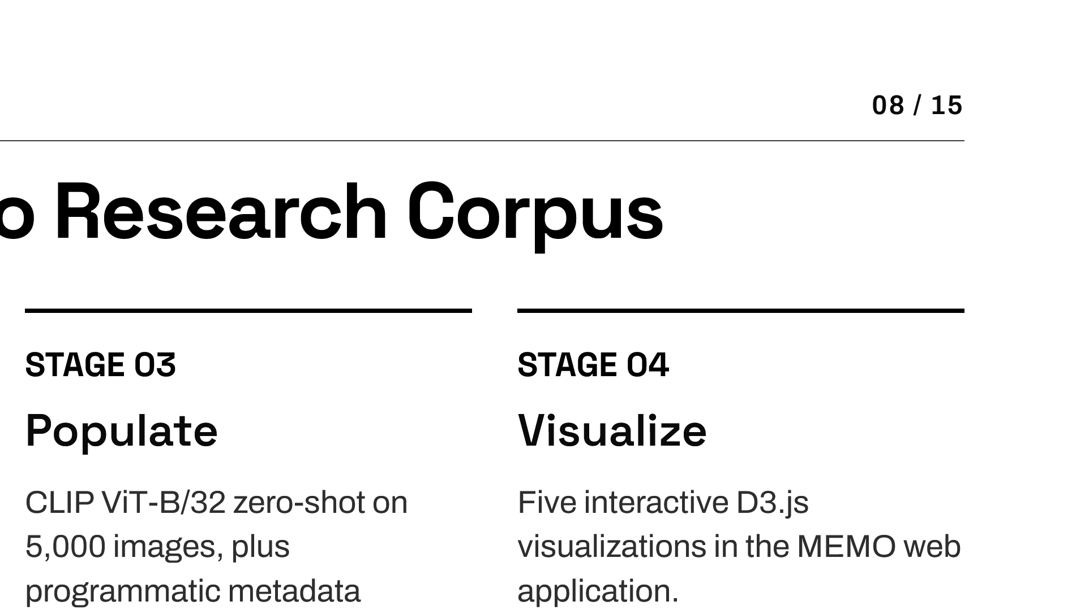
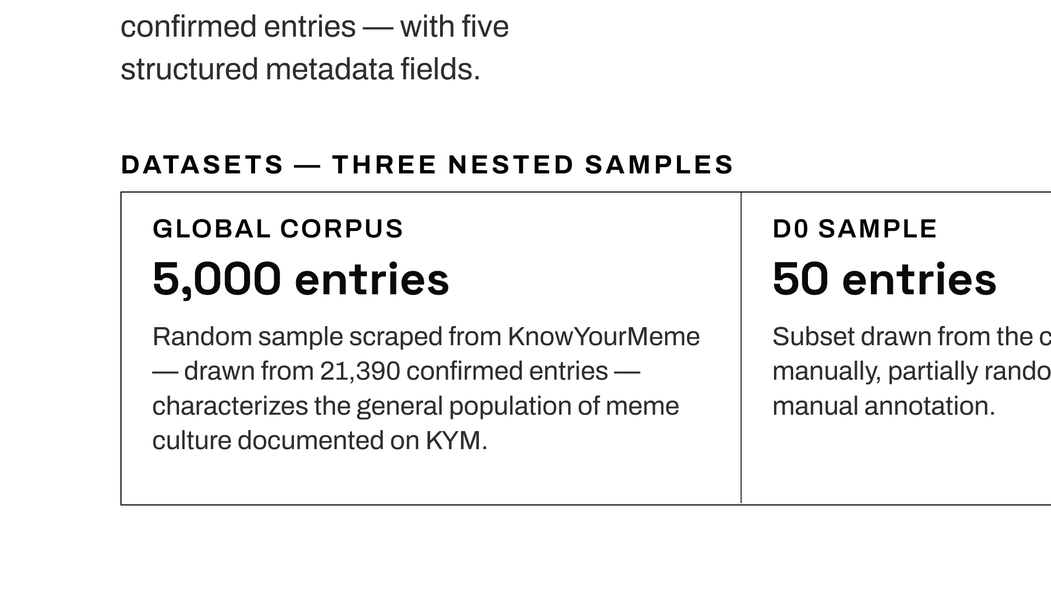
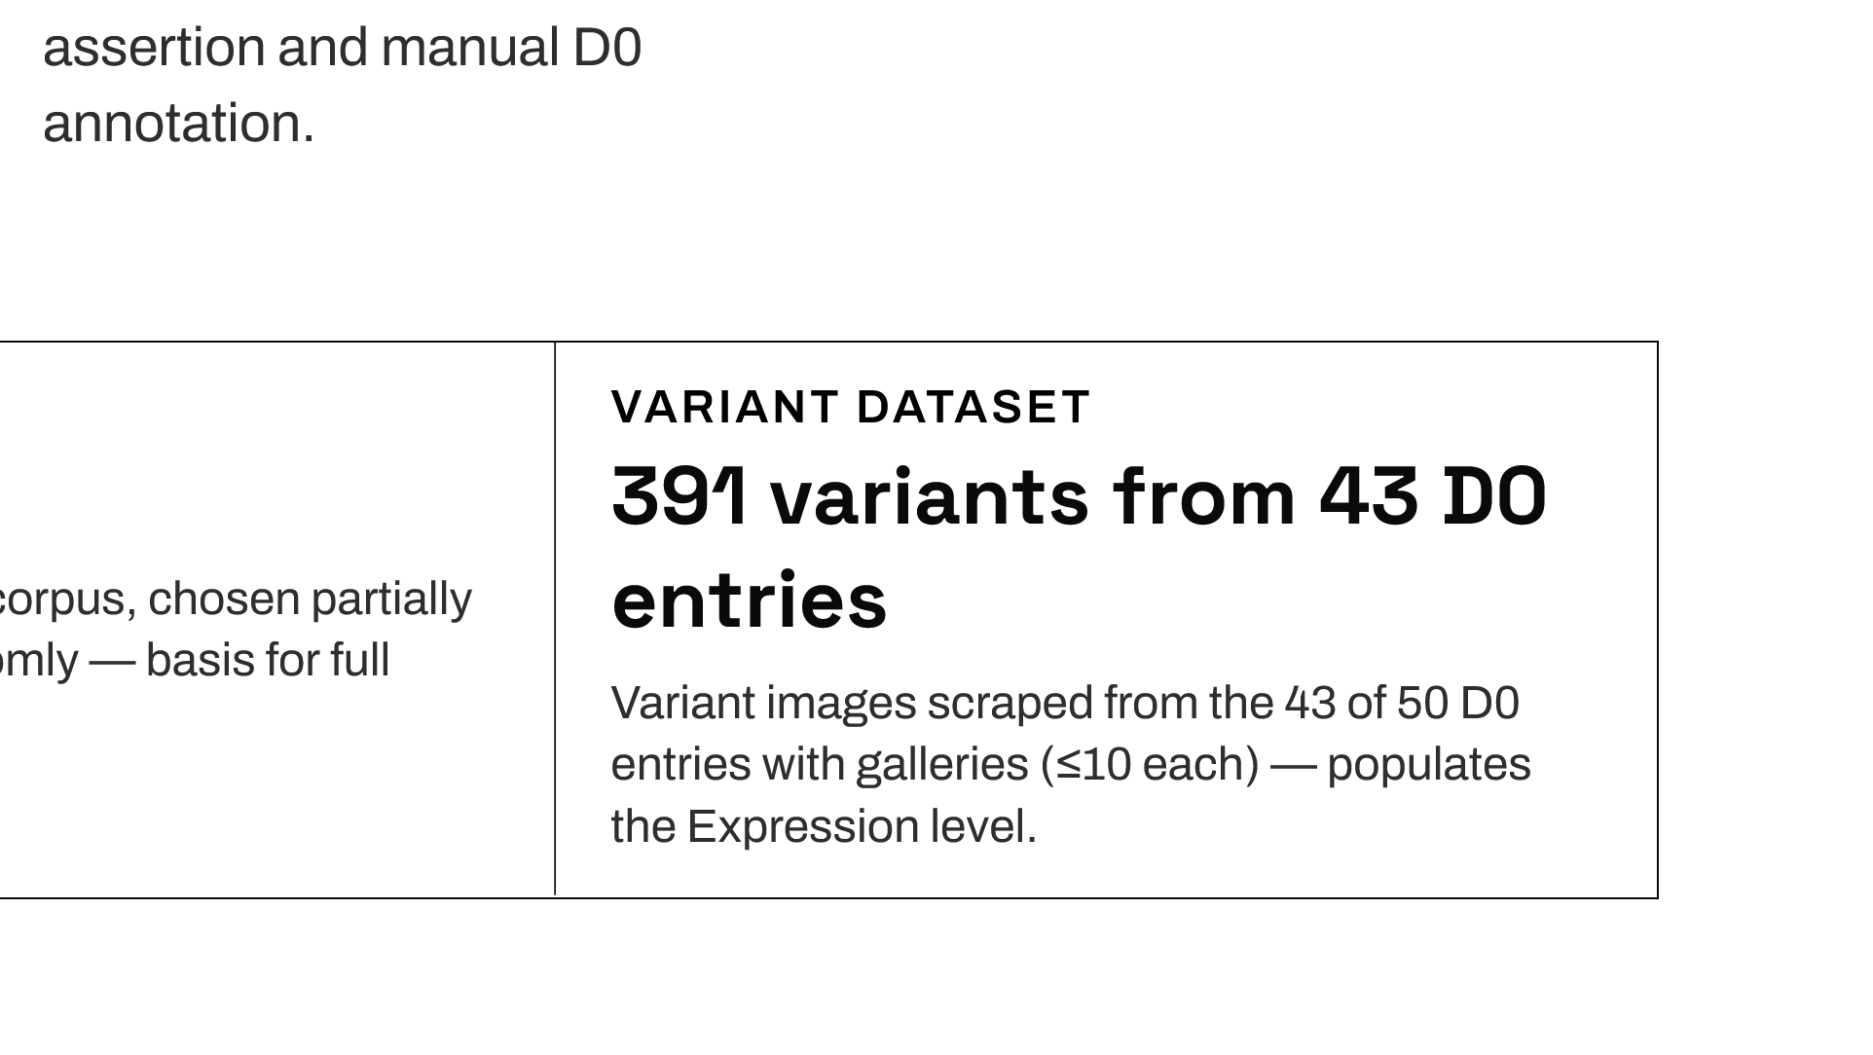
Notes:
A four-stage pipeline turns a community archive into a research corpus: scrape KnowYourMeme, model the ontology, populate it through CLIP plus programmatic and manual annotation, and visualize it in a web application.

Slide 9
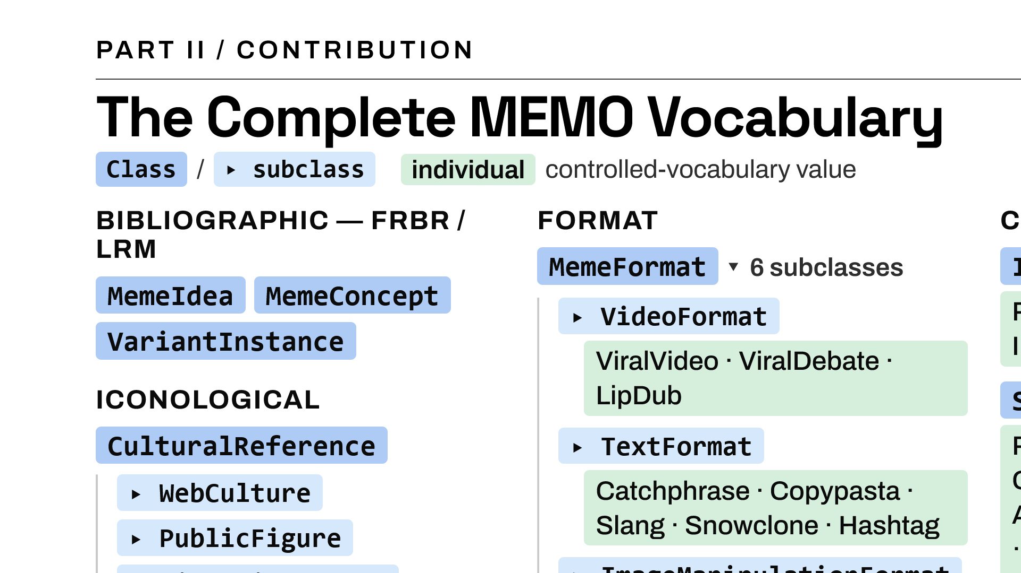
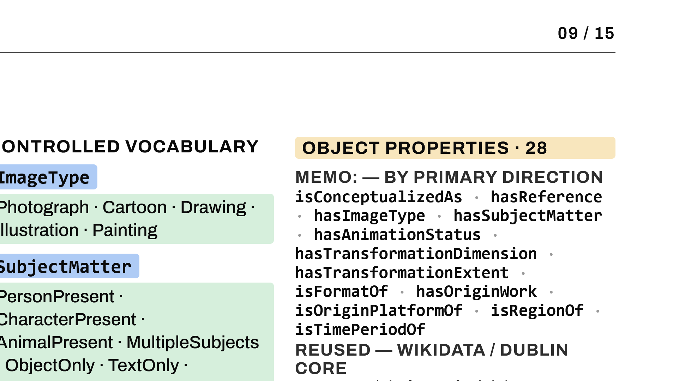
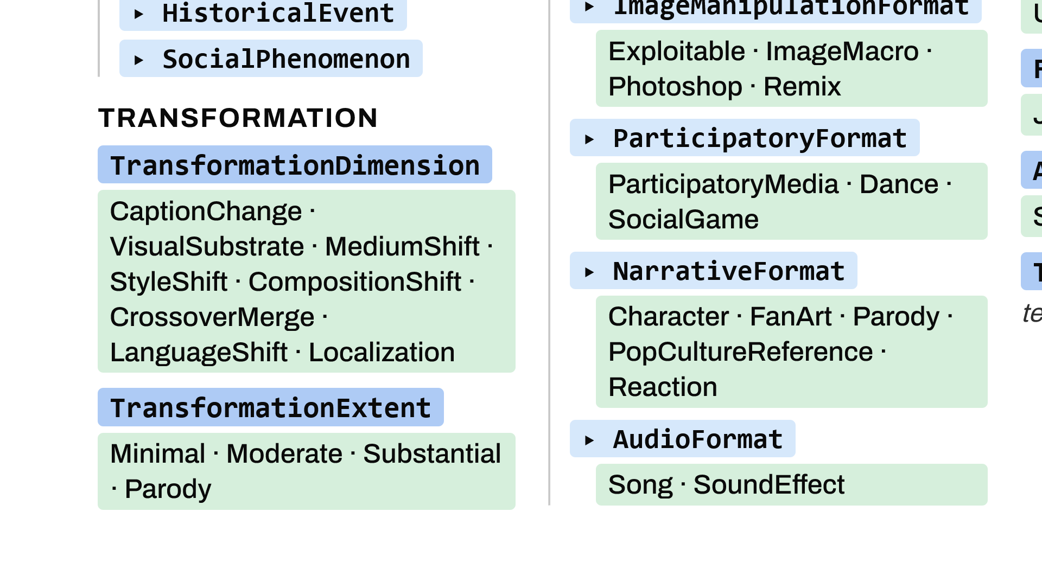
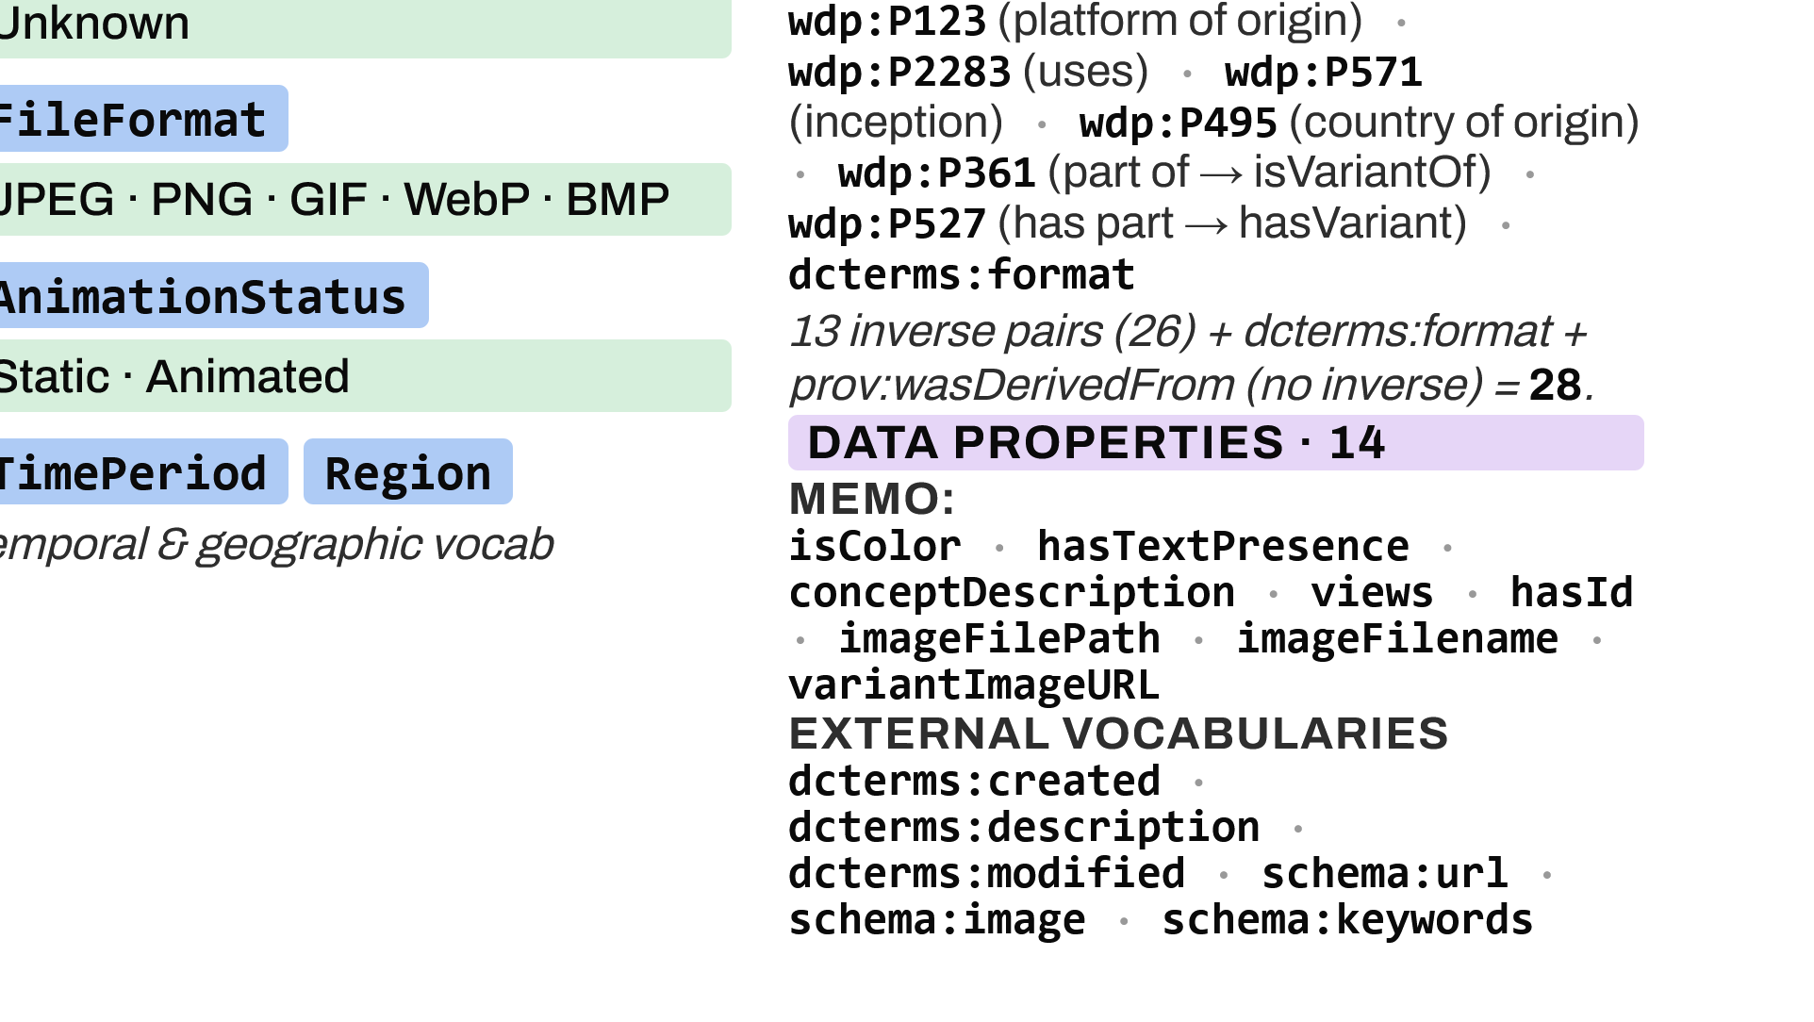
Notes:
For reference, the complete MEMO vocabulary with its closed controlled-vocabulary individuals: 33 classes — the bibliographic and iconological backbone, the six MemeFormat subclasses grouping 36 format individuals, the transformation typology, and the visual controlled vocabularies; 28 object properties; and 14 data properties. The named individuals shown are the full closed vocabularies the annotation pipeline draws on.

Slide 10
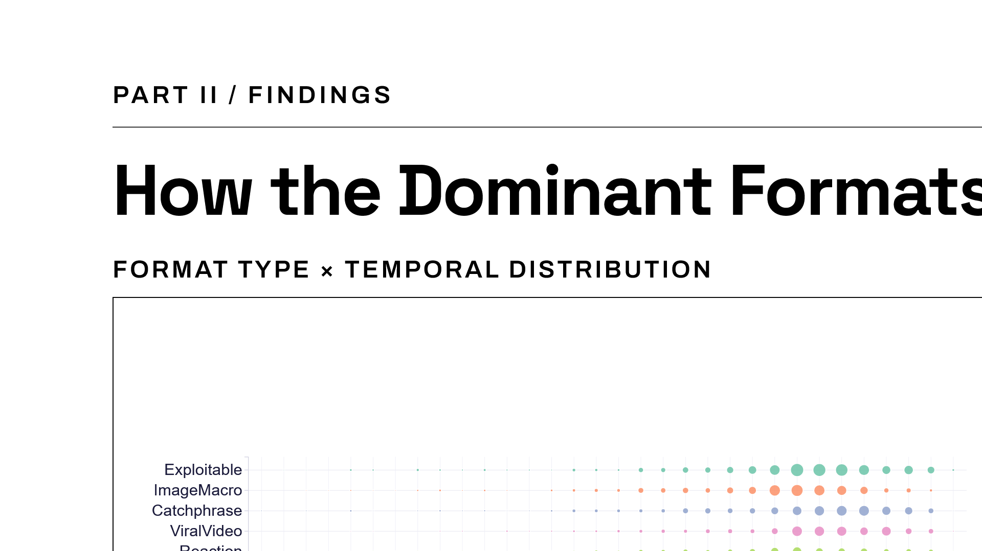
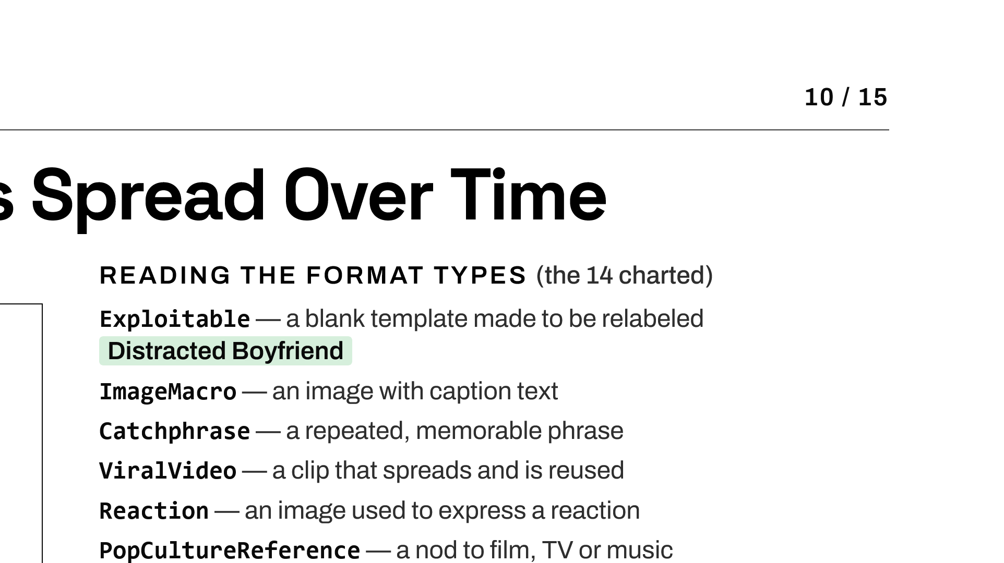
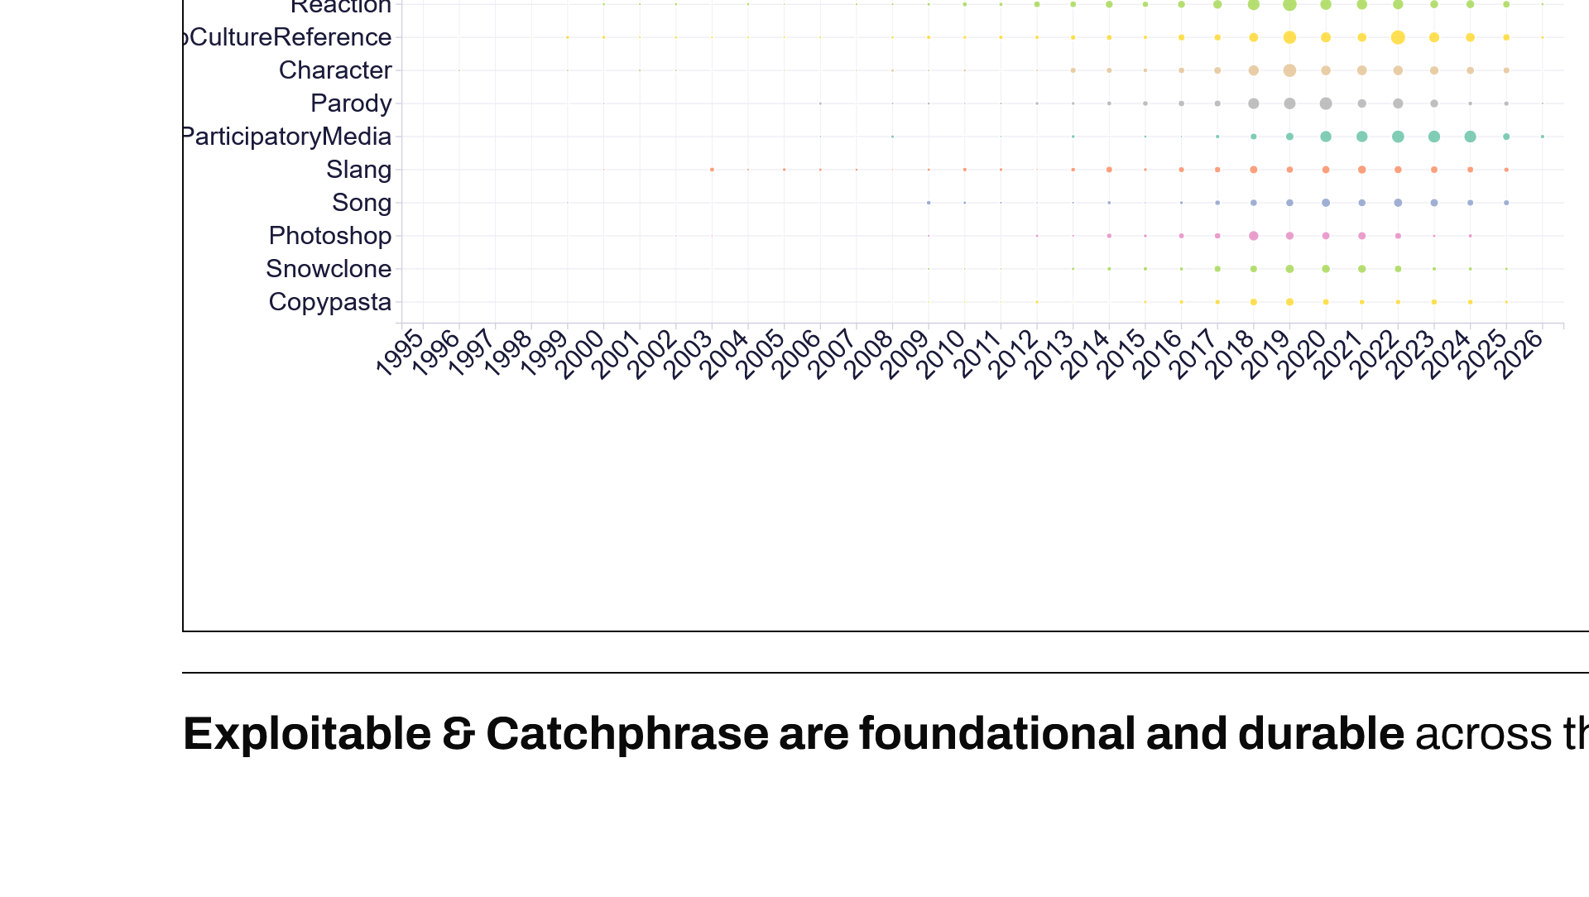
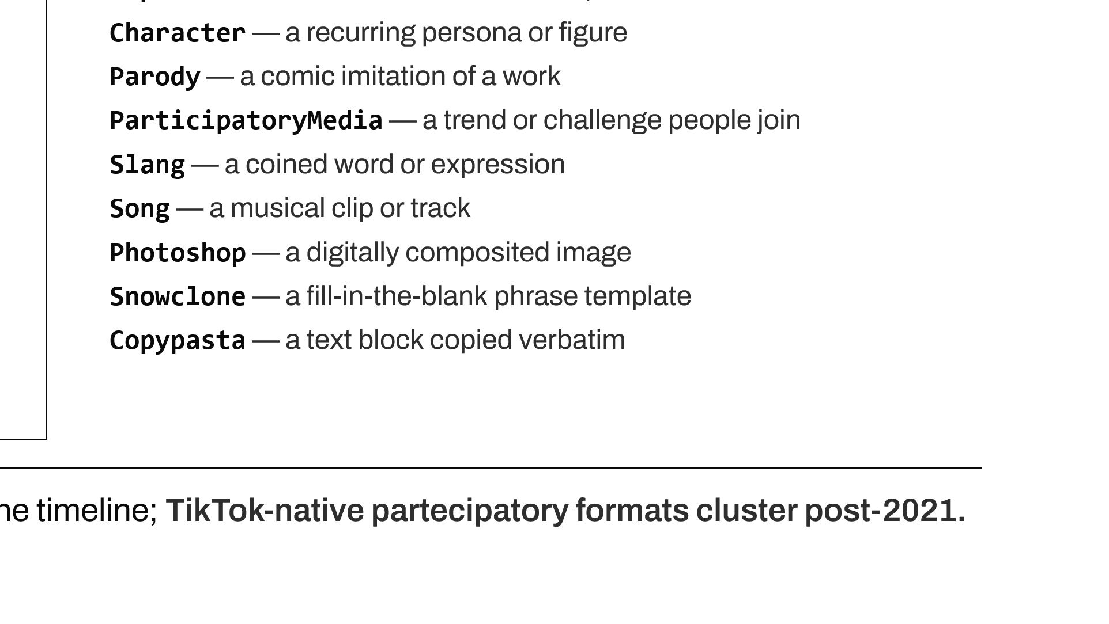
Notes:
The first corpus-level finding is temporal. Exploitable, image-macro and catchphrase formats are foundational and durable across the whole period, while TikTok-native formats cluster sharply after 2021 — a shift from the static image to short-form video as the dominant carrier of meme culture.

Slide 11
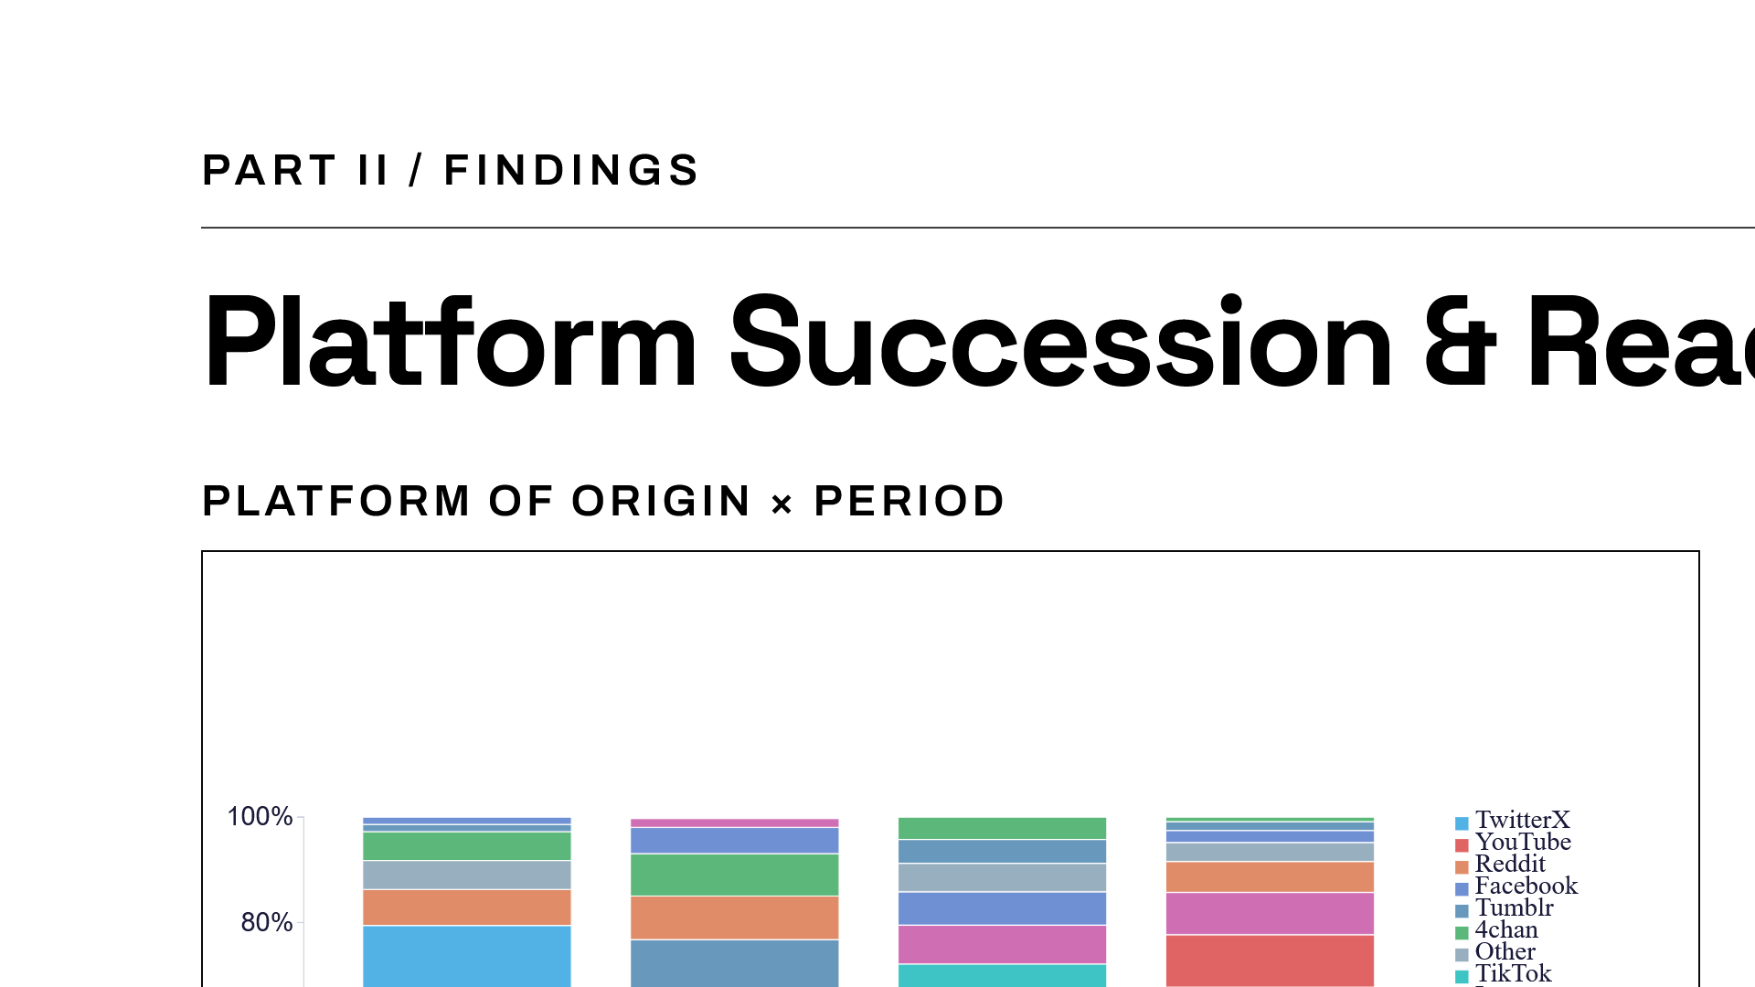
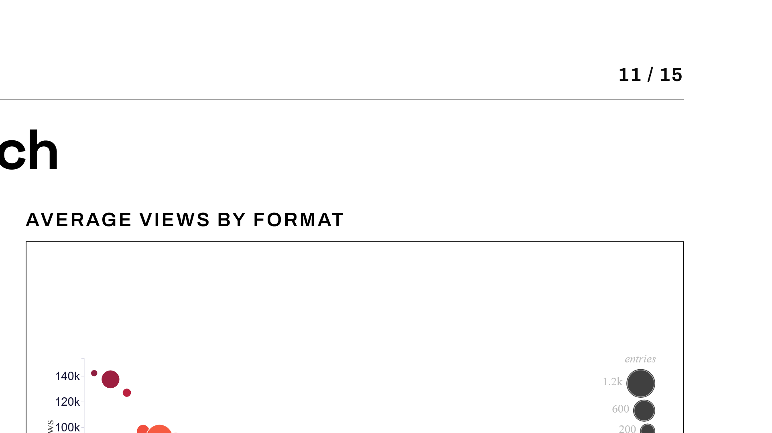
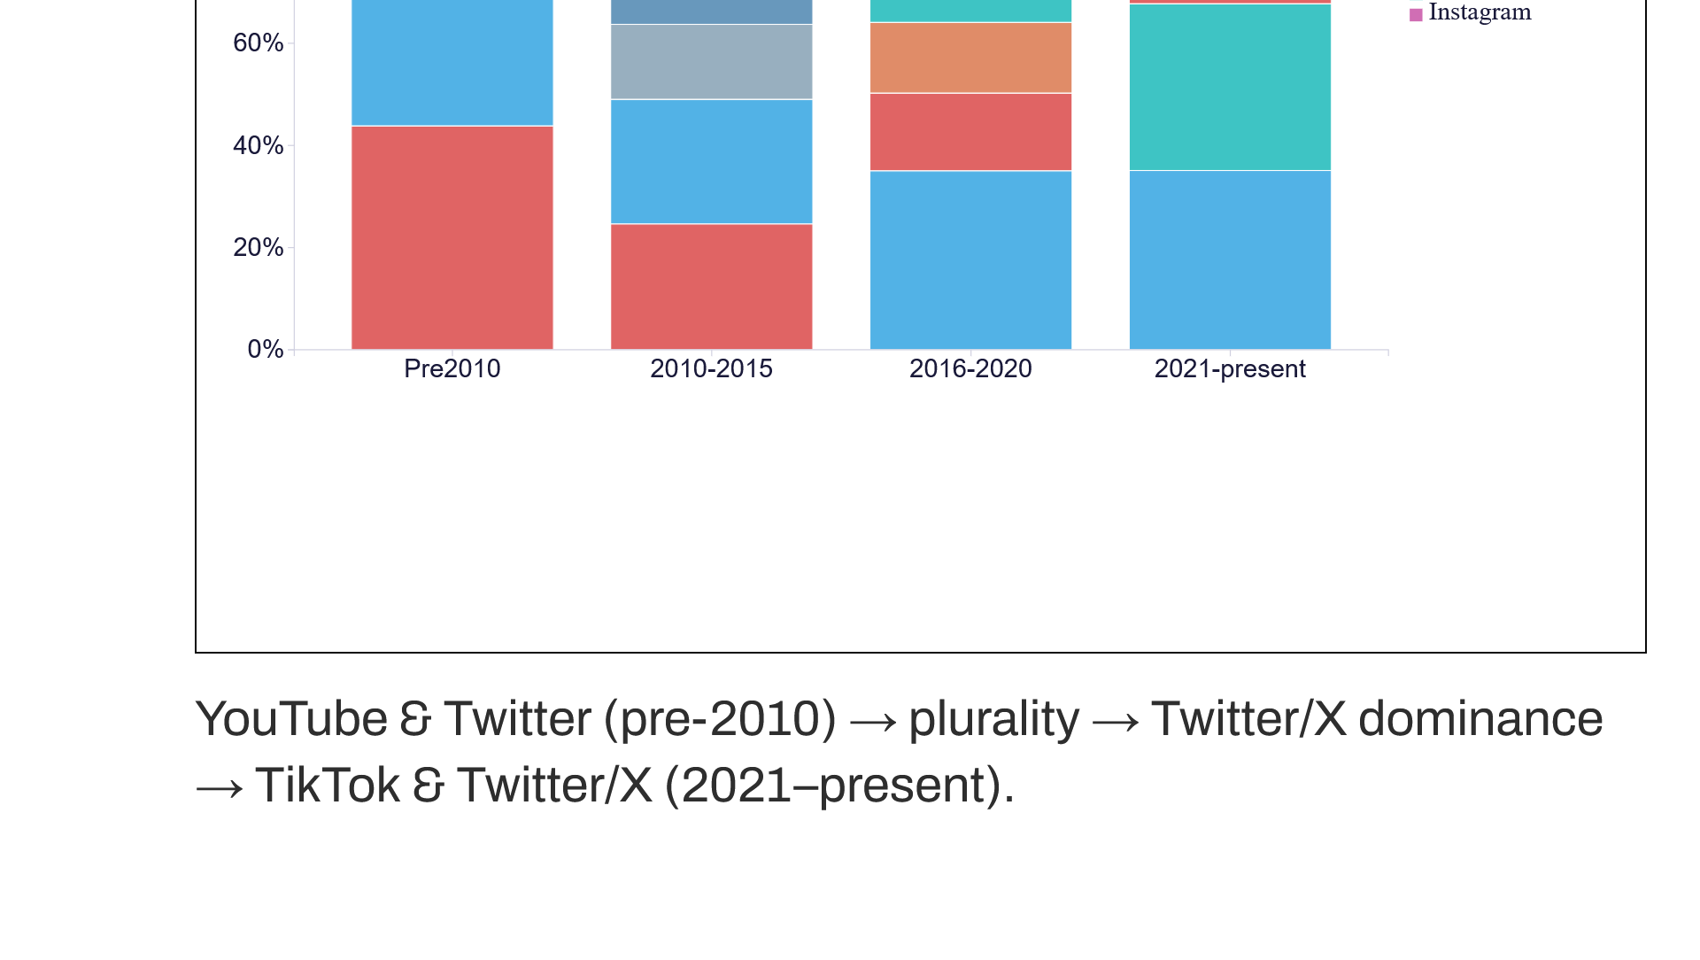
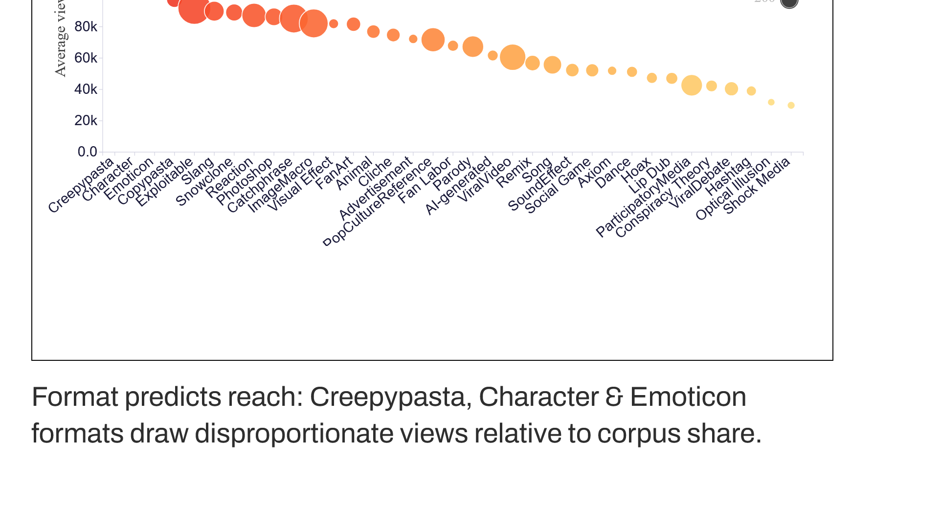
Notes:
Two further corpus-level findings. Platform attribution traces a succession — YouTube and Twitter in the early period, a phase of platform plurality, then Twitter/X dominance, and finally the rise of TikTok and Instagram from 2021. And format category predicts cultural reach: Creepypasta, Character and Emoticon formats draw disproportionate average view counts relative to their share of the corpus.

Slide 12
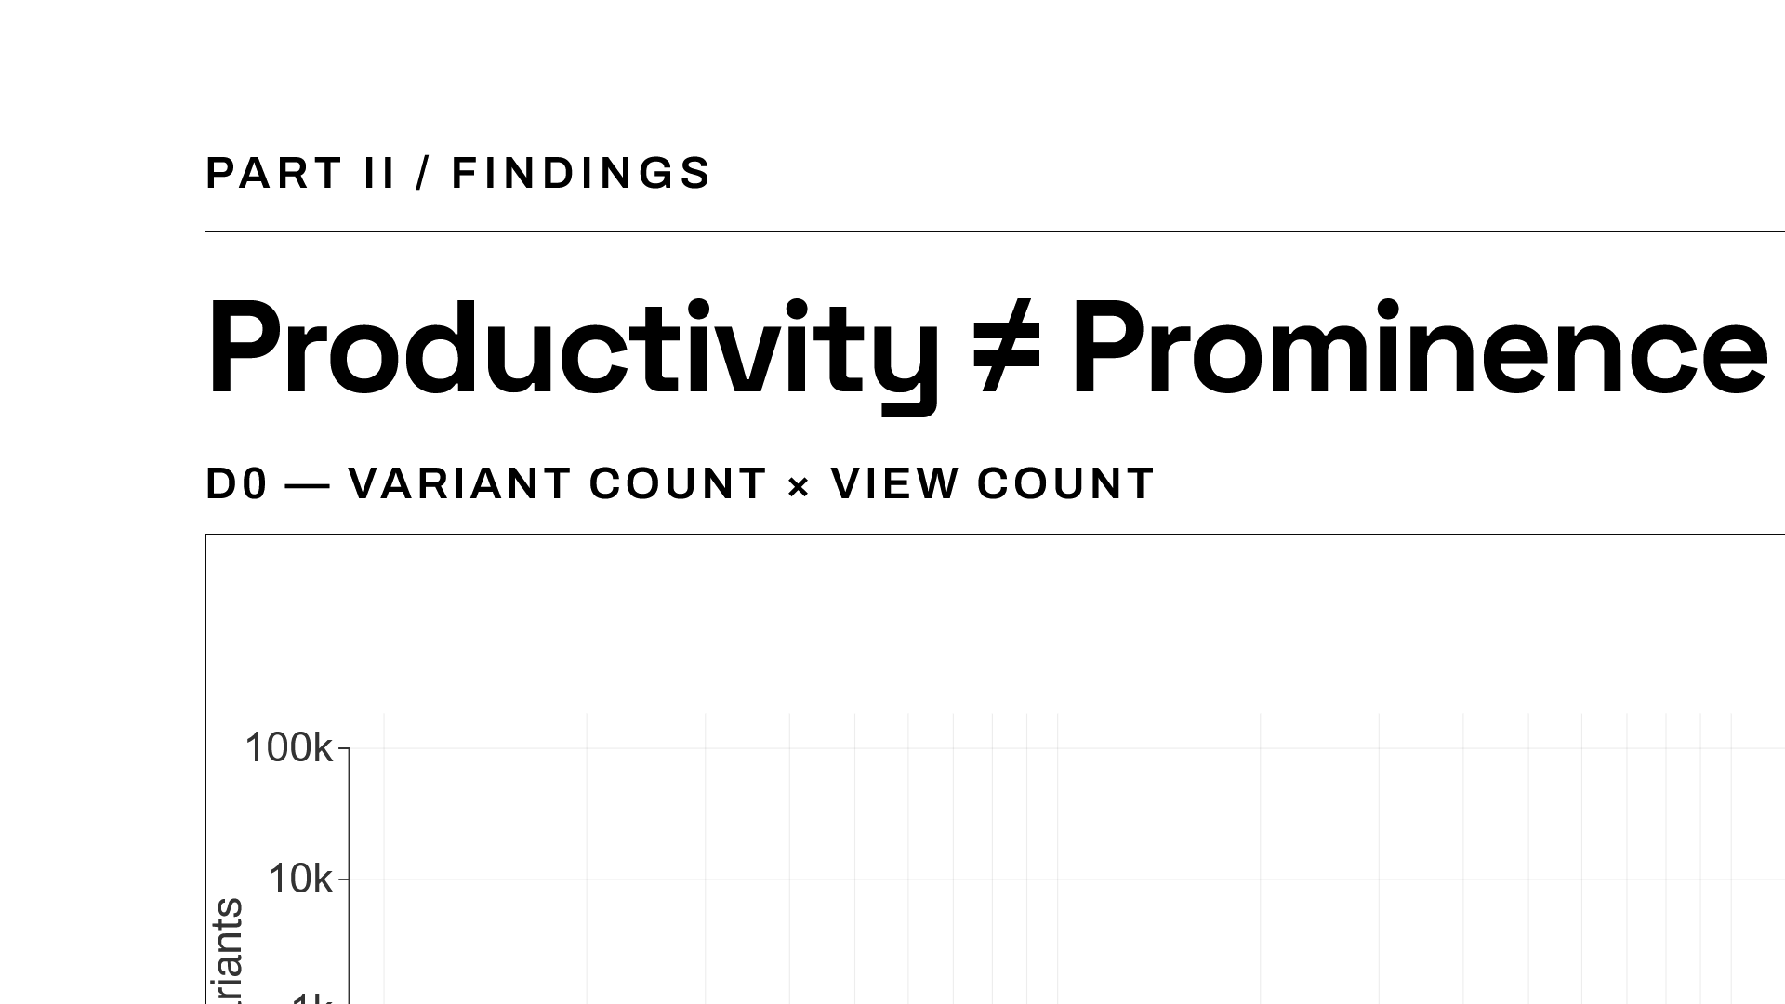
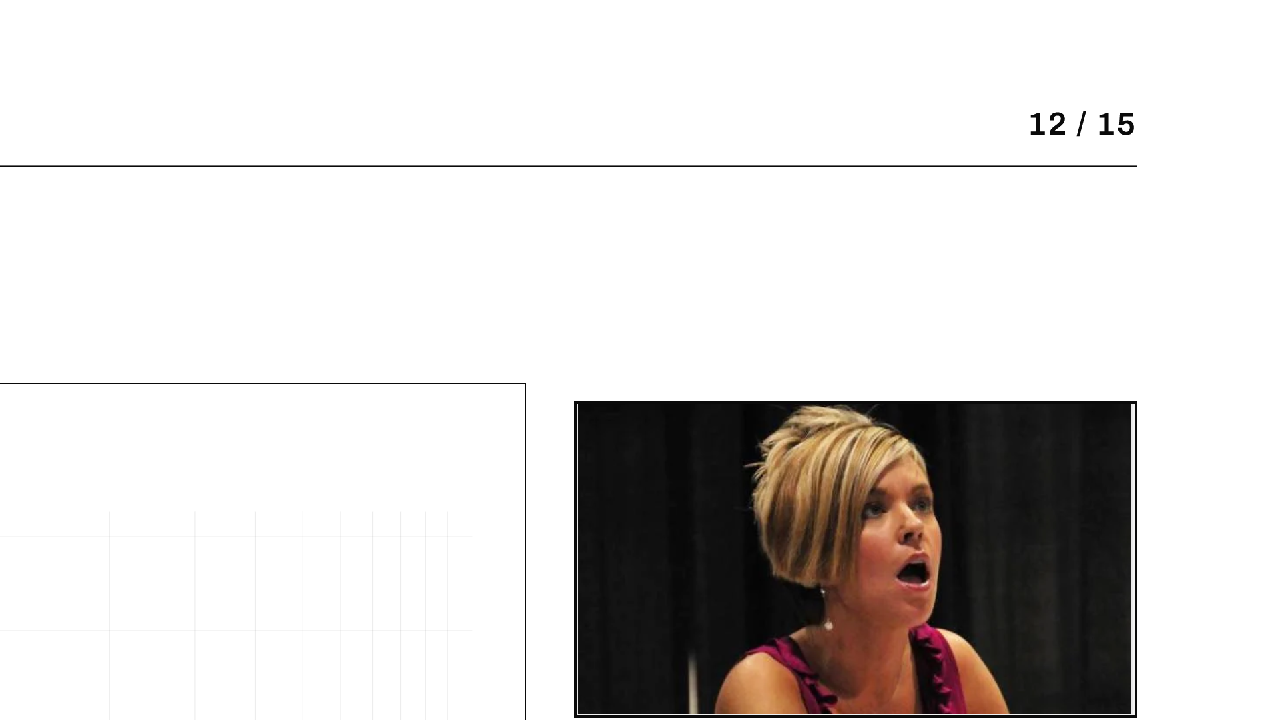
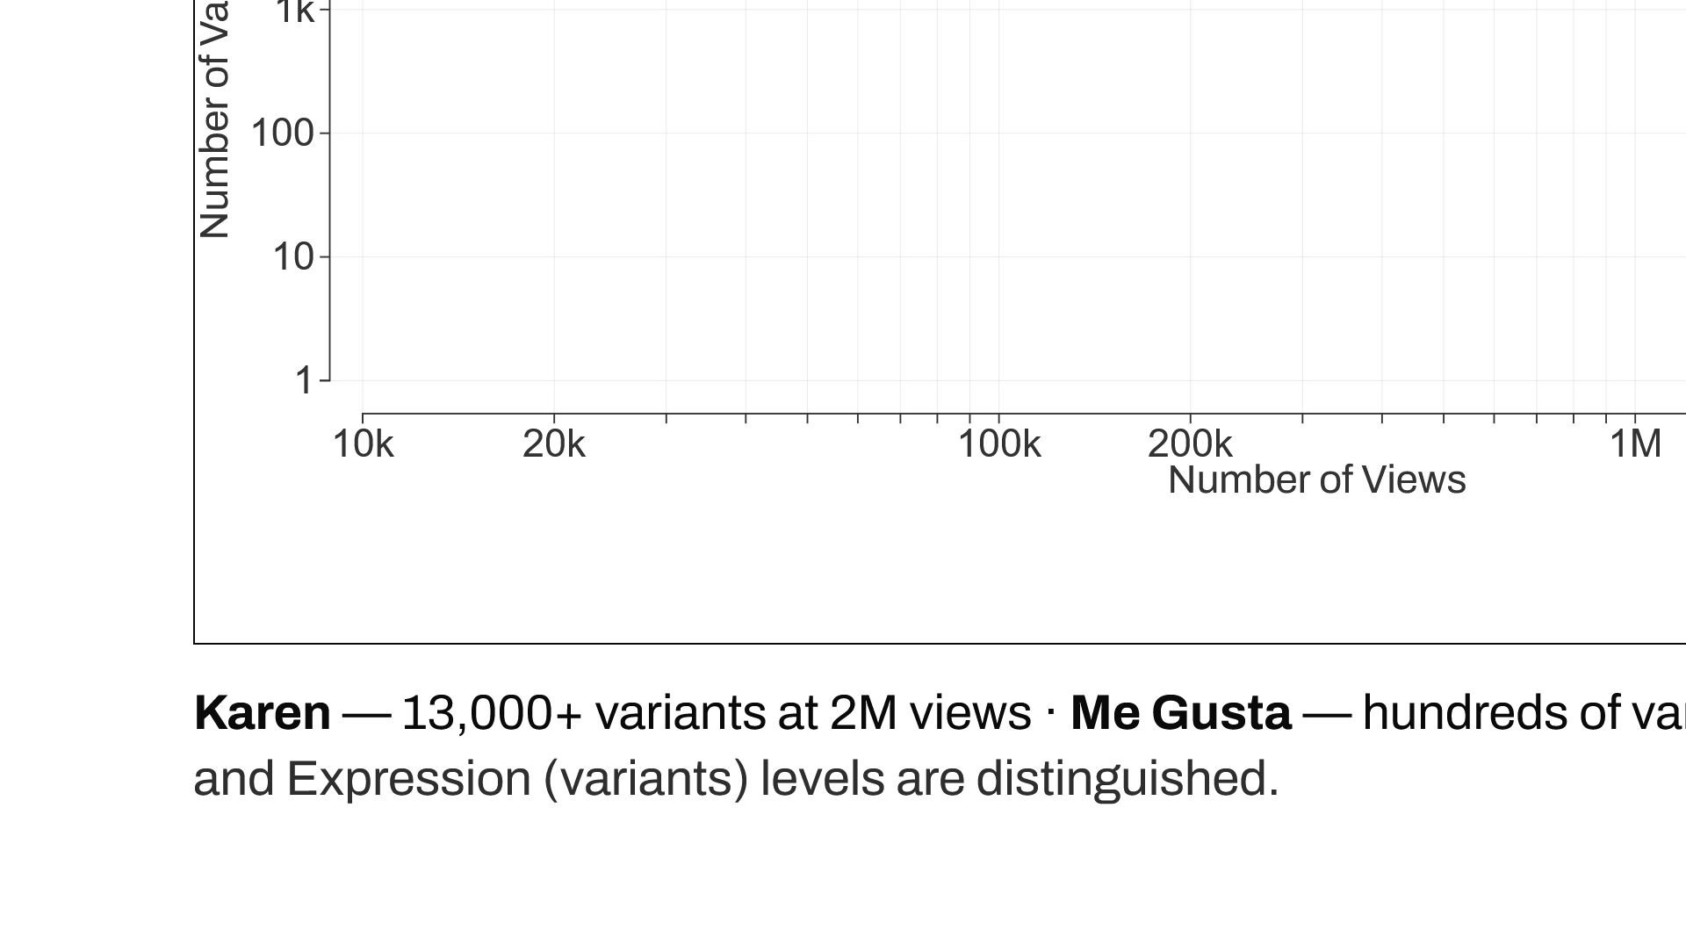
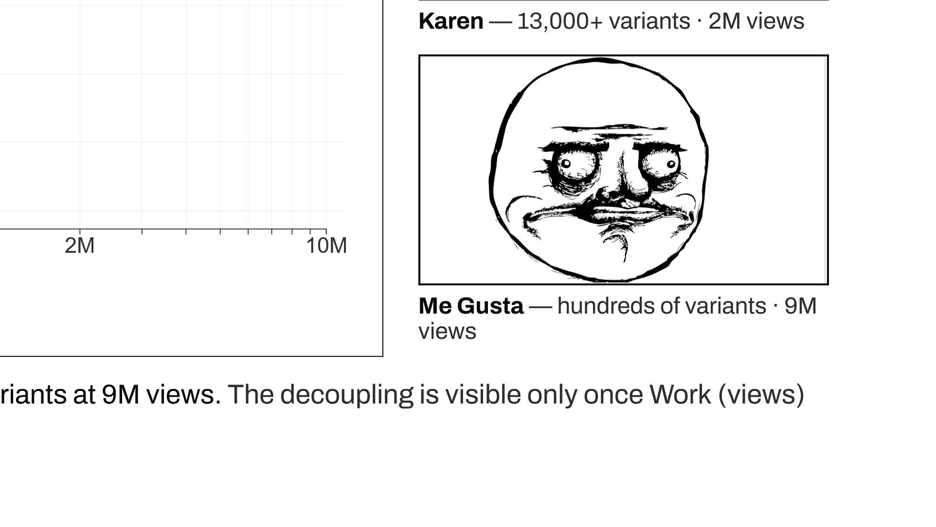
Notes:
At the D0 level, separating the Work level (views) from the Expression level (variant count) reveals a decoupling: Karen generates over 13,000 variants at 2 million views, while Me Gusta generates hundreds at 9 million. The two dimensions are independent — productivity is not prominence.

Slide 13
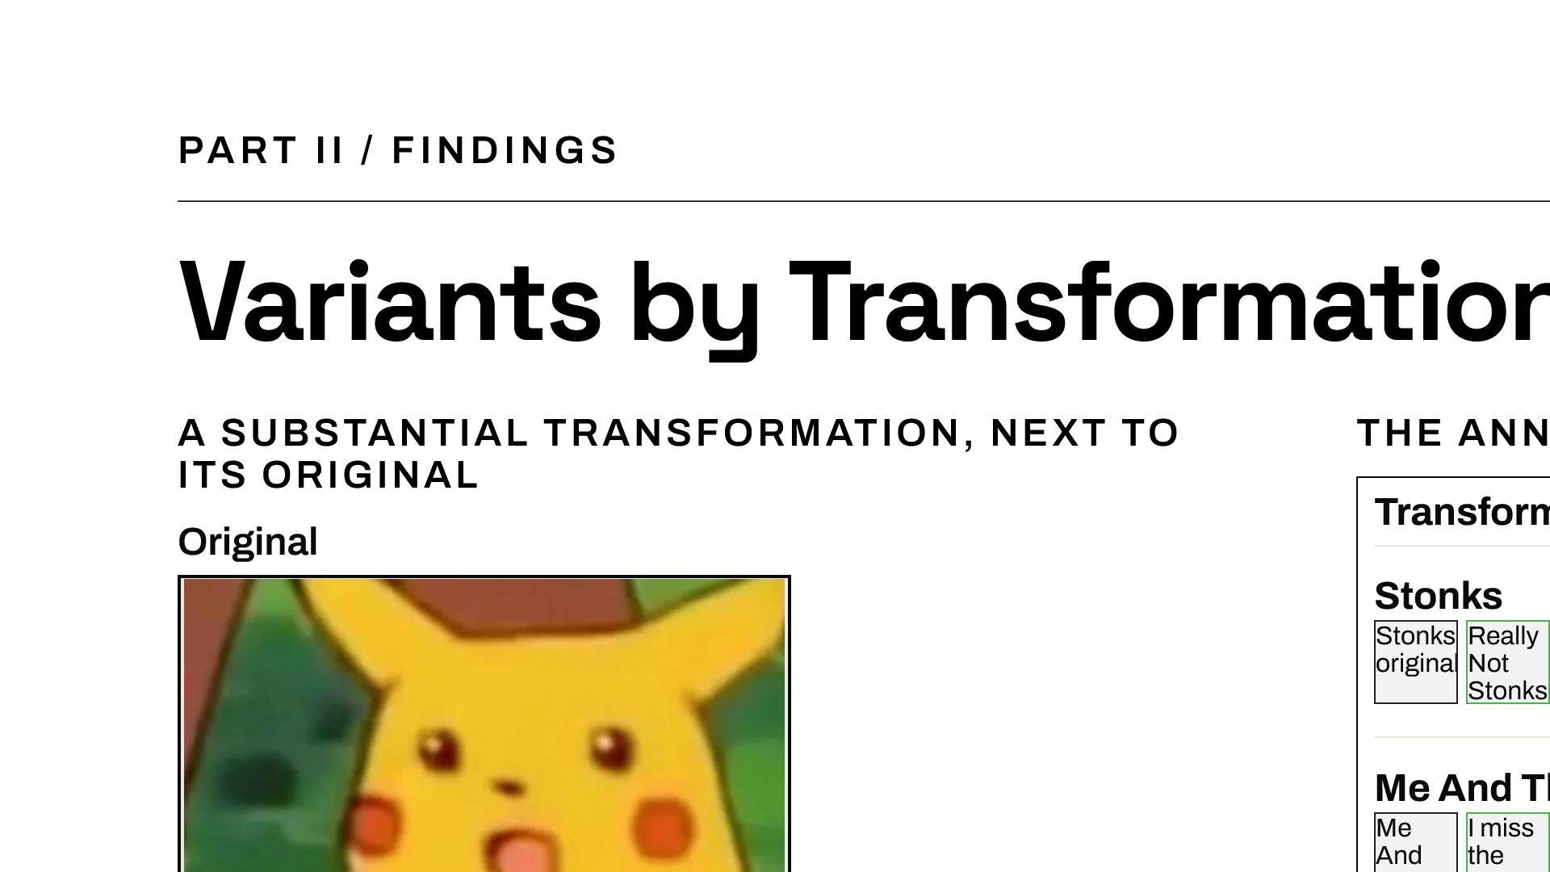
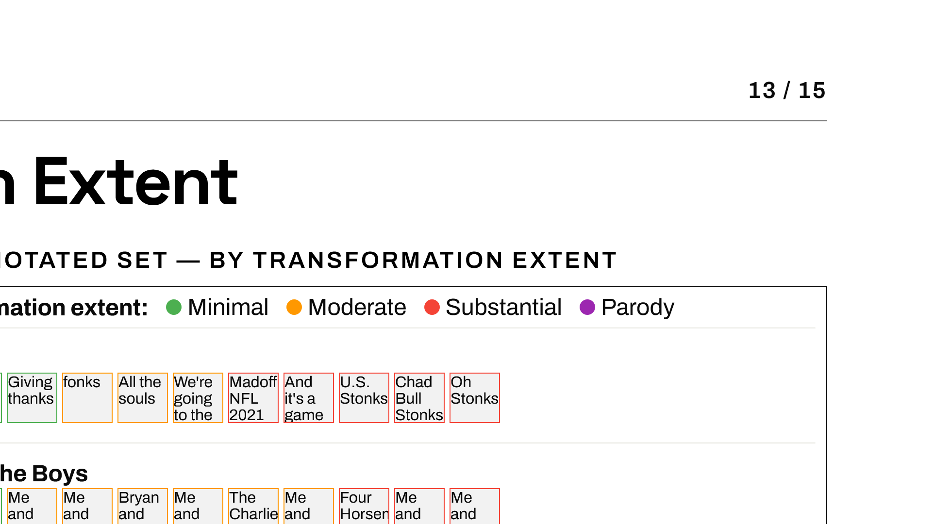


Notes:
At the Expression level, variants depart from their template by varying degrees. Placing a substantially transformed variant beside the original makes the transformation typology concrete: the same template, recognizably reworked. Across the annotated set, variants range from minimal caption swaps to substantial re-compositions and parodies.

Slide 14




Notes:
All four questions are answered affirmatively, with qualifications. The most important qualification is RQ2: CLIP partially works but produces systematic hallucination, assigning the top prompt regardless of confidence. The honest conclusion is that single-pass zero-shot trades reliability for completeness.

Slide 15




Notes:
To conclude: MEMO is the first formal OWL 2 DL ontology of internet memes at corpus scale. It shows community archives can be transformed into research corpora without losing cultural intelligence, provided we stay transparent about the interpretive character of the source. The first ontology of memes is a beginning, not a conclusion. Thank you.

